Slide 1
A
FIRST DAY
Presentation for the WG
plenary meeting
9h00 – 10h00
7th of March 2019

Slide 2
COST ACTION CA15137
Opening, Podgorica, 7th of March 2019
European Network for Research Evaluation in the SSH

Slide 3
multimedijalna sala
Password: skcucg17112015

Slide 4
Agenda
New participants
Changes in steering positions
Deliverables
Dissemination matters

Slide 5
New countries and participants
Two countries: Moldova and Albania
New ENRESSH Members (since the last MC meeting):
Marta Wróblewska, Todor Hristov Dechev,
Miomir Maros, Thomas Franssen, Zoe Bulaitis,
Robert Kulmiński, Laura James

Slide 6
New Chair, Science Communication Manager & WG4 Leader
Former Chair: Ioana Galleron (ENRESSH Founding mother)
New chair: Emanuel Kulczycki
Science Communication Manager: Stefan de Jong
Former WG4 Leader: Geoffrey Williams
New WG4 Leader: Stefan de Jong

Slide 7
Reimbursement procedure
Marek Hołowiecki

Slide 8
Reimbursement procedure
You have received a one-page document with the most important information.
Submit to the Grant Holder a completed OTRR within
30 calendar days after the end date of this meeting.
Do not hesitate to contact me if you have any doubts.

Slide 9
Reimbursement procedure
Local transport expenses
within the boundaries of one country
Local transport expenses - up to 25 EUR - no receipts
Local transport expenses - more than 25 EUR - all receipts

Slide 10
Reimbursement procedure
Local transport expenses
within the boundaries of one country
TAXI - always receipt (with a clear date, provider’s name)
TAXI - up to 80 EUR for the entire journey
before 7 am to facilitate an early departure
after 10 pm due to a late arrival.

Slide 11
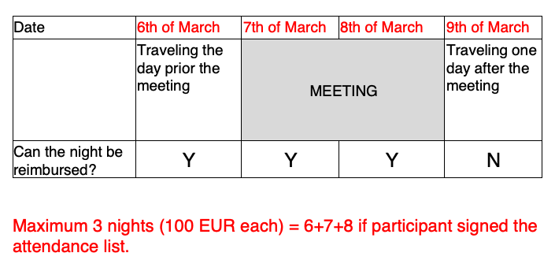
Reimbursement procedure
Accomodation

Slide 12
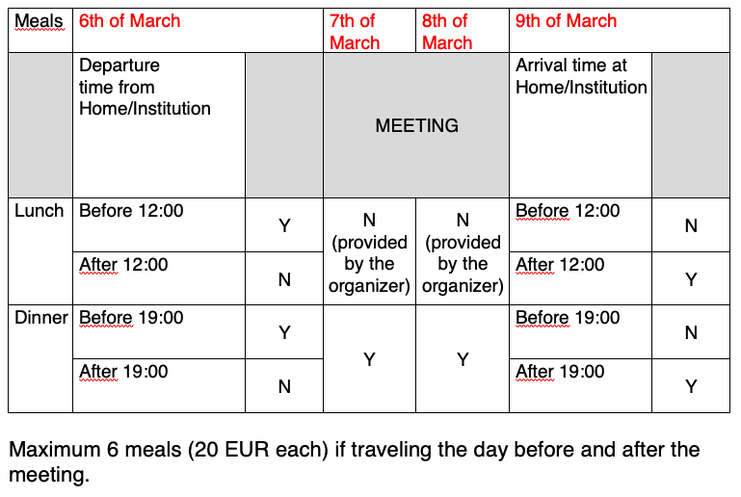
Reimbursement procedure

Slide 13
Reimbursement procedure
Do not hesitate to contact me if you have any doubts.

Slide 14
Dissemination matters
Stefan de Jong

Slide 15
Three and two-country rules for publications
ENRESSH Deliverables
1) Direct result of work performed by the action
2) Participants from THREE different participating COST countries
3) Preferably published as Open Access publications
4) https://enressh.eu/links_and_literature/enressh-deliverables/
ENRESSH Outputs
1) Participants from TWO different participating COST countries
2) https://enressh.eu/links_and_literature/enressh-publications/
Please, inform me (stefan.dejong@manchester.ac.uk) about deliverables and outputs!

Slide 16
Dissemination matters
Ongoing
Policy brief
Newsletter
Zotero
List of Institutions
Final year
Messages & Stakeholders
#SSHEvaluation
WG Dissemination coordinators
Expert Panel

Slide 17
STSMs
Mimi Urbanc

Slide 18
STSM
3 calls were published:
WP1: 4 topics called, 3 STSMs granted;
WP2: 7 topics called, 7 STSMs granted;
WP3: 6 topics called, 6 STSMs granted;
ECI: 1 topic called, 1 STSM granted.
All together 17 STSMS granted: 15 visiting scholars, 8 host researcher.

Slide 19
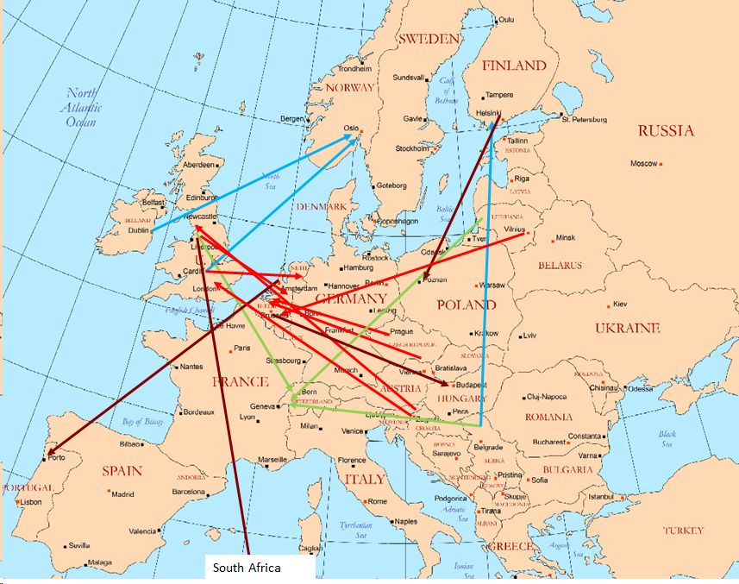
STSM mobility directions
to FI, NO
to UK, BE, NL
to CH
to other places

Slide 20
Realised STSM, WP1, Lendák-Kabók
Karolina Lendák – Kabók, Uni Novi Sad, RS; Host: Michael Ochsner, FORS, CH;
Main aims: finalize the development of a standardized questionnaire for SIG ECI, development of a concept for the fieldwork for the international survey;
Main activity: The formulation of the questions, formulation of the fieldwork for the questionnaire;
Findings/results: finalized questionnaire prepared for testing, solvation of the problem of how to field the questionnaire;
To do activities: data collection, data analysis, joint publication.

Slide 21
Realised STSM, WP1, Gedutis
Aldis Gedutis, Klaipeda Univ, LT; Host: Maria T. Biagetti, Sapienza Uni of Rome, IT;
Main aims: to get new insights into understanding of knowledge production and dissemination in the SSH from an ethical perspective;
Main activities: analysing and comparing ethical theories, sources on research and evaluation ethics;
To do: to interview scholars; to compare and combine the materials; to elaborate tentative guidelines for research evaluation ethics; to write an academic article.

Slide 22
Realised STSM, WP1, Ross-Hellauer
Tony Ross-Hellauer, Know-Center GmbH, AT; Host: Gemma Derrick, Lancaster Uni, UK;
Main aims: to identify ways in which differences in methods, epistemology and publication structures influence the needs for peer review in various SSH disciplines;
Main activity: Literature review and theoretical analysis;
Findings/results: We argue that SSH have been colonised
by non-SSH values and that this, in turn, influences how the peer review process functions to promote SSH innovation and value.

Slide 23
Realised STSM, WP2, Wroblewska
Marta Natalia Wróblewska, UK/Poland; Host: Paul Benneworth, Uni of Twente, NL;
Main aim: Delineating the field of SSH impact: lessons from an expert (29) survey;
Findings/results: the contingency of the process of producing knowledge and expertise in the area of impact, identification of an important centre-periphery issue;
To do activities: A reflexive study on the process of constructing knowledge” paper.

Slide 24
Realised STSM, WP2, Balaban
Name Corina Balaban, Uni of Manchester, UK, host: M. Iseli, Swiss Academy of Social Sciences and Human., CH
Main aim: to collect data about the Swiss research context regarding societal impact of the SSH.
Main activity: conducting interviews with research’s policy-makers and stakeholders; collecting policy documents; conducting interviews with department leaders and academics.
Findings/results: in the Swiss model, ‘impact’ does not feature very strongly.

Slide 25
Realised STSM, WP2, Wroblewska
Marta Natalia Wróblewska, UK/Poland; host: Jon Holm: Research Council of Norway (RCN), NO;
Main aim: Comparative study of NO and UK impact case studies;
Main activity: comparison of corpus of 31 NO impact case studies and (previously studied) corpus of 78 UK impact case studies;
Findings/results: British CSs focus on persuasion (self-promotion), Norwegian ones on information.
To do: Final report to be published soon as working paper!

Slide 26
Realised STSM, WP2, Balaban
Corina Balaban, Uni of Manchester, UK; host: Sarah de Rijcke, Leiden Uni, NL;
Main aim: to analyse the open answers from a set of 100 questionnaires collected as part of the CARES project; the thematic focus was on motivations and identities of ECRs in relation to societal impact.
Findings/results: there were strong motivations for ECRs to engage in ‘impactful’ research;
To do: paper for the ENRESSH meeting in Valencia in Sept 2019.
:

Slide 27
Realised STSM, WP2, de Jong
Stefan de Jong, UK/NL, Host: Nelius Boshoff, South Africa;
Main aim: to identify impact conceptualisations in contexts in which impact is not (yet) institutionalized, taking sub-Saharan Africa as a case.
Main activity: analysis of a survey (n=485), of national policy and university strategy documents, writing a paper.
Findings/results: impact is implicitly part of science policy, SSH impacts least recognized as impact.

Slide 28
Realised STSM, WP2, Good
Bradley Good, Vrije Uni Amsterdam, NL; Host: Rita Faria, PT;
Main aim: to identify hierarchies and normative aspects of power within a societal impact ecosystem;
Main activity: analysing the 2018 ECI survey conducted by the ENRESSH CARES sub-committee;
Findings/results: significant barriers to societal impact for ECIs are systemic, however these same barriers, once identified, can lead to potential improvements and changes.
To do: writing a report, due by the end of March.

Slide 29
Realised STSM, WP2, Vanholsbeeck
Mark Vanholsbeeck, BE, hosts: Andrea Peto, Karolina Lendák-Kabók, CEU Budapest, HU;
Main aim: to get an insight into early career building in SSH beyond the sole meritocracy: formal and less formal ways to learn the tricks of the academic trade; the diversity in impact conceptualization and engagement: accounting for local and epistemic contexts (CARES).
Main activity: analysing SIG interviews and CARES questionnaires;
Findings/results: “Information channels” are diverse, recruitment is often non transparent.

Slide 30
Realised STSM, WP3, Daniel
Ondřej Daniel, Metropolitan Uni Prague, CZ; Hosts: Tim Engels & Raf Guns, Centre for R&D Monitoring (ECOOM), BE;
Main aims: to provide a qualitative analysis of core journals for 4 SSH disciplines (Anthropology, Political Science, History, Arts, Art history,) located in three countries (PL, CZ, HR);
Main activities: data preparation, analysis, and reporting of findings;
Main results: overview and a comparison; presentation at ECOOM, finalize submission for MDPI journal Publications.

Slide 31
Realised STSM, WP3, Ivanovic
Dragan Ivanovic, Uni Novi Sad, SR; host: Hanna-Mari Puuska, CSC – IT Center for Science Ltd, FI;
Main aims: to investigate the potential use of international metadata standards, CERIF in particular in harvesting and exporting publication data in the frame of the ENRESSH-VIRTA;
Main activities: Matching of CERIF entities’ properties to ENRESSH-VIRTA data model entities’ properties; and implementation of OpenAIRE guidelines for CRIS managers
To do: organizing an STSM in Novi Sad.

Slide 32
Realised STSM, WP3, Petr
Michal Petr, Masaryk Uni Brno, CZ; host: Tim Engels & Raf Guns, University of Antwerp, BE;
Main aims to analyze the coverage of SSH articles (Czech Republic, Poland, Slovakia, Flanders, Norway) in WOS.
Main activities: preparation of the data, analysis (in progress);
Main results: a comparison of countries in terms of the share, coverage and reputation of journals (in progress);
To do: prepare submission for RESSH 2019.

Slide 33
Realised STSM, WP3, Ma
Lai Ma, Uni College Dublin, IE; host: Gunnar Sivertsen, Nordic Institute for Studies in Innovation, Research and Education, NO;
Main aim: to understand how metadata construction in commercial and national databases may affect research evaluation of SSH;
Main activities: draft grant proposal and articles pertaining to the topic of research evaluation in SSH;
Main results: Submission to ISSI Conference, Seed Funding Scheme (University College Dublin).

Slide 34
Realised STSM, WP3, Jermen
Nataša Jermen, Miroslav Krleža Institute of Lexicography, CR; host: Rupert Gatti, Open Book Publishers, UK;
Main aims: to provide a qualitative analysis of HIRMEOS project aimed at prototyping innovative metrics service for OA scholarly monographs;
Main results: comparison of the different publication platforms. and overview of the HIRMEOS; a case study on Twitter usage of a book recently published by Open Book Publishers (in progress).

Slide 35
Realised STSM, WP3, Pölönen
Janne Pölönen, FI; host: Emanuel Kulczycki: Adam Mickiewicz Uni in Poznań, PL;
Main aim: Comparison of SSH journal article patterns across seven European countries;
Main activities: Integrating Finnish SSH researcher and output data to analysis; preparing a journal list; identifying 6 topics of study;
Main results: 76 % of the Finnish SSH researchers publish only in one language, 23 % use two and 1 % use three or more languages;
To do: a paper on multilingualism, papers on the other topics.

Slide 36
Realised STSM, ECI, Šinkūnienė
Name: Jolanta Šinkūnienė, LT; Host: Marc Vanholsbeeck, BE.
Main aim: to investigate information, support and resources available to ECI / lacking by ECI;
Main activity: analysing 50 fiches from the interviews with ECI from 14 countries; nn
Findings/results: country profiles of information, support and resources types developed; key aspects relevant for ECI in terms of information, support, resources identified; recommendations for ECI support formulated.

Slide 37
Agenda for the meeting
Emanuel Kulczycki

Slide 38
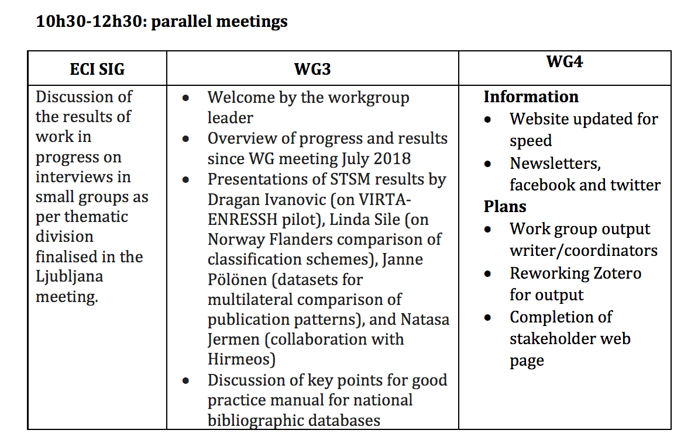
Agenda for two days

Slide 39
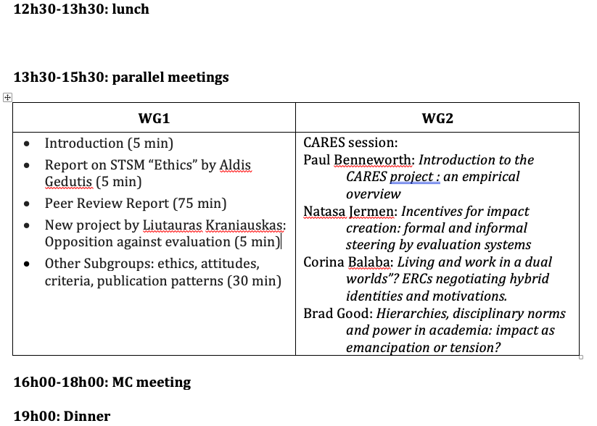

Slide 40
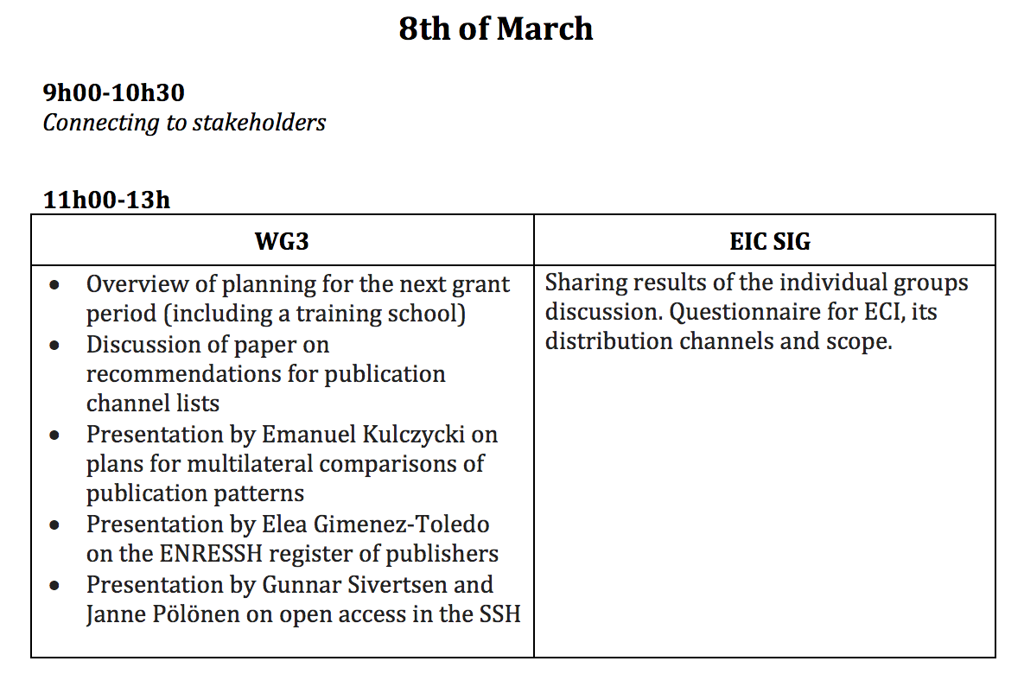
Tomorrow, 8th of March

Slide 41
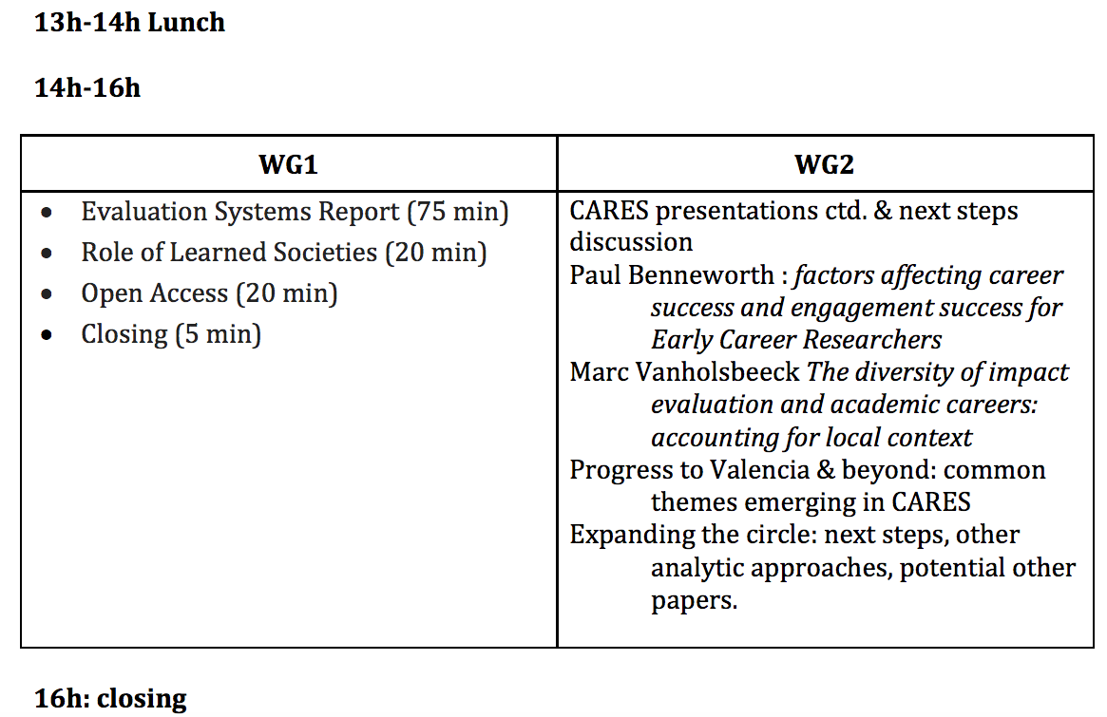

Slide 42
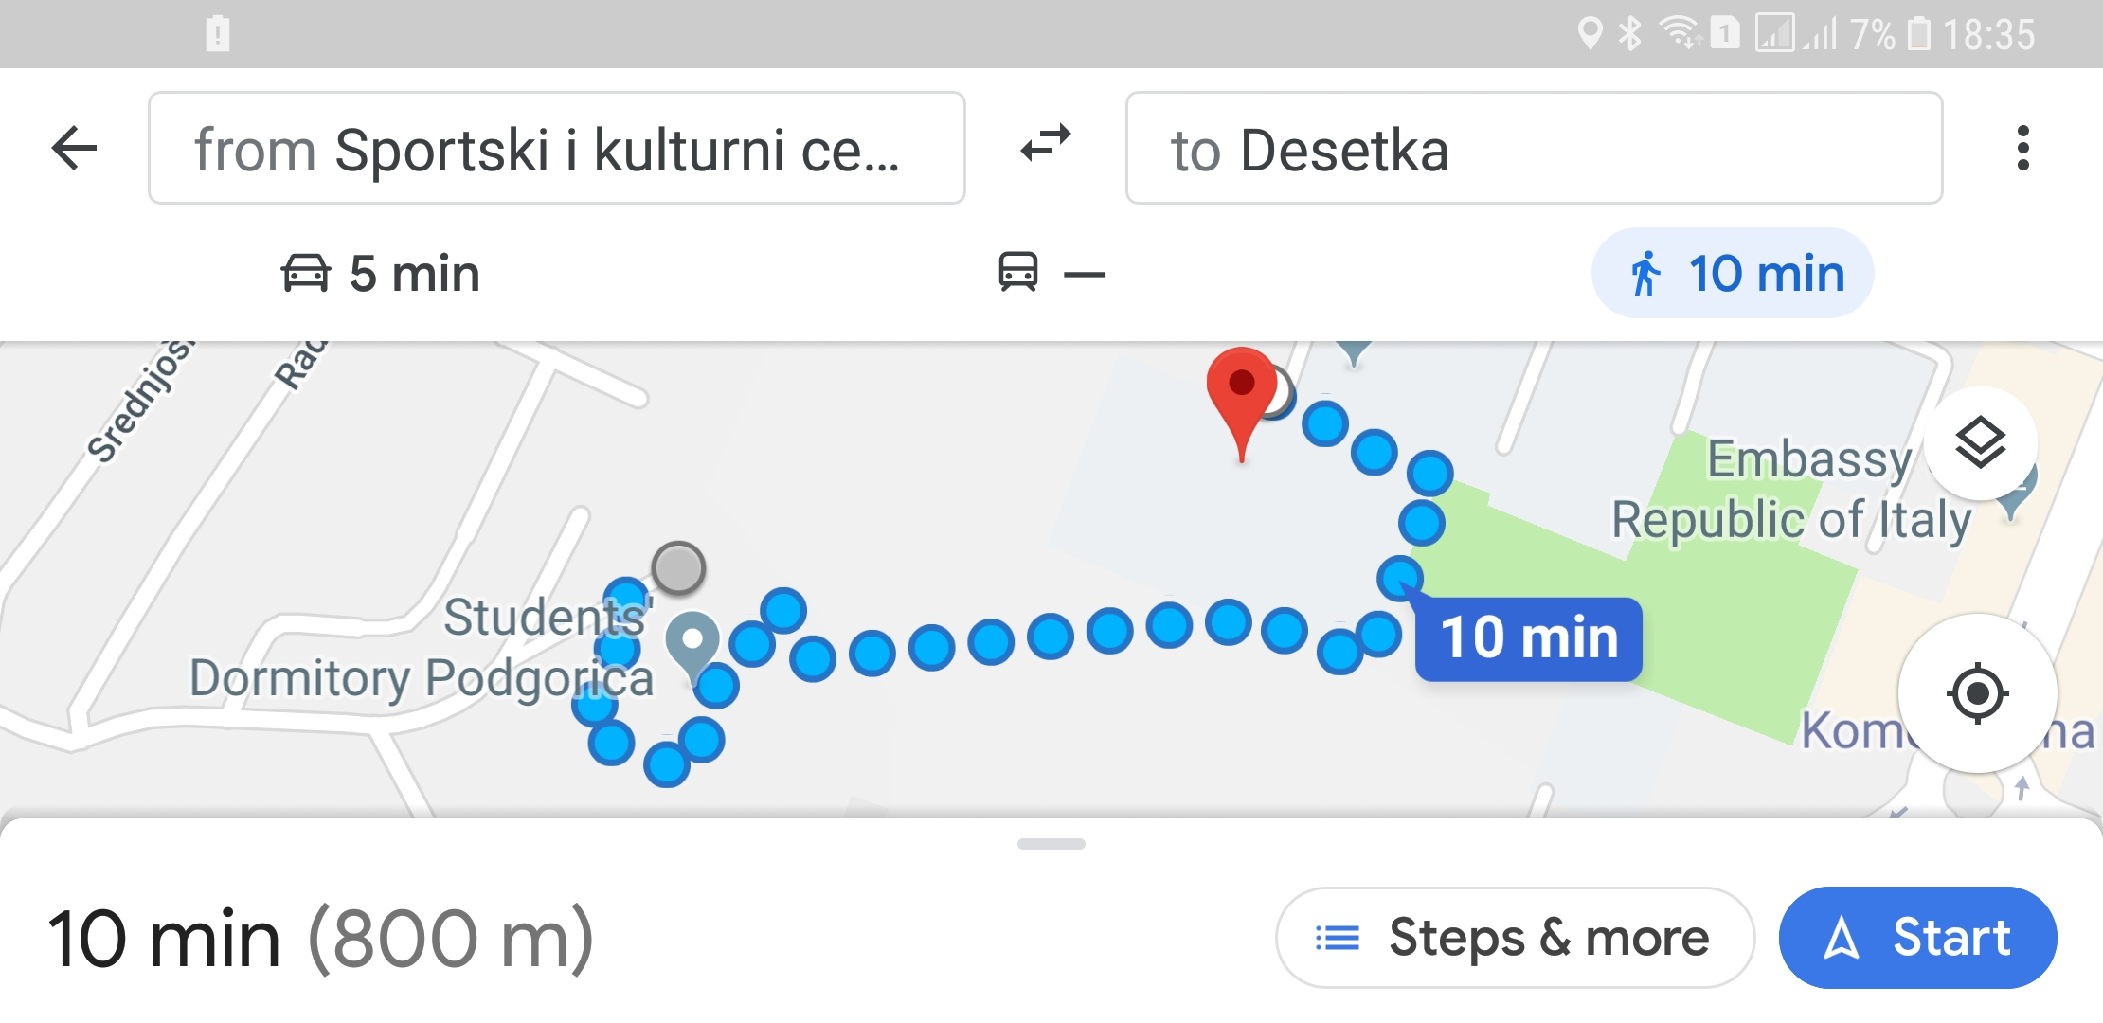
Joint dinner: 7th of March
Restaurant “Desetka”. 19:00-21:00

Slide 43
Have a fruitful meeting!
and write the minutes.

Slide 44
B
FIRST DAY
Presentation for
the MC meeting
16h00 – 18h00
7th of March 2019

Slide 45
COST ACTION CA15137
MC meeting, Podgorica, 7th of March 2019
European Network for Research Evaluation in the SSH

Slide 46
Quorum
37 countries having signed the MoU
Quorum at 2/3 (25 countries)
NNC and IC only observers (no voting rights)

Slide 47
Agenda
Update from the Action Chair
Update from the Grant Holder
Follow-up of MoU objectives: progress report of working groups
ENRESSH Fellows
ENRESSH day
ITC Grant Manager
Helsinki Initiative
Scientific planning
AOB

Slide 48
Update
from the Action Chair
Emanuel Kulczycki

Slide 49
Update from the Action chair
Key facts
CSO approval: October 2015
Kick-off: 8th of April 2016 > end of the Action in
7th of April 2020
Start of fourth GP: 1st of May 2019 (> end on 7th of April 2020)

Slide 50
Update from the Action chair
A new country has signed the MoU: Albania

Slide 51
1c. Gender, country, age balance
Country balance
Researchers come from all over Europe, no imbalance between East/ West, North/ South
7 STSMs out of 17 in GP3 concerned participants from ITC

Slide 52
1c. Gender, country, age balance
Age balance
51 out of 158 participants (approx. 32% )
Active SIG for ECI
Involvement of ECI in steering positions: Chair, Grant Holder, Leader of WG1, vice-leader of WG2, Leader of WG4, Science Communication Officer, direction of SIG ECI
11 STSM out of 31 concerned ECI

Slide 53
1c. Gender, country, age balance
Gender balance
68 women out of 142 participants (approx. 48% )
Involvement of women in steering positions:STSM coordinator, vice-leader of WG2, leader of SIG ECI
16 STSMs out of 31 awarded to women

Slide 54
1d. Inclusiveness and excellence
Instrument for supporting participation of researchers from NNCs in international conferences
2 conference grants awarded (out of 2 demands)
Stimulation of co-signed publications via STSM and WG meetings

Slide 55
Update
from the Grant Holder
Marek Hołowiecki

Slide 56
2. Update from the grant holder
218.922,92 euros awarded (but only 87.869,19 euros transferred in September 2018)
144.728,47 euros spent to date
By the end of the GP, we’ll have spent 90% of the budget

Slide 57
Follow-up of
of MoU objectives
Work Group Leaders

Slide 58
3. Follow-up of MoU objectives
Work groups
WG1. Conceptual frameworks for SSH research evaluation.
WG2. Societal impact and relevance of the SSH research.
WG3. Databases and uses of data for understanding, monitoring and evaluating SSH research.
WG4. Dissemination.
+ transversal special interest group for early stage researchers
+ transversal special interest group on book

Slide 59
Tasks and Deliverables for WG1
Our tasks in the action are (always for SSH research)
  T1: collect, review, conduct studies on knowledge production and dissemination (incl. quality perceptions)
  T2: Analyse quality representations and assumptions in peer review
  T3: Observe national regulations, recommendations, procedures for research evaluation and their effects on knowledge production
  T4: Overview quality criteria based on scholars’ notions of quality

Slide 60

Tasks and Deliverables for WG1
Our main deliverables are:
  D1: List of projects on quality perceptions in participating countries
  D2: Overview of research evaluation practices
  D3: Overview of peer review practices
  D4: Scientific papers and presentations
  D5: Training School: Evaluation procedures and impact on careers
  D6: Recommendations for better adapted criteria and indicators
  D7: Bibliography
  D8: Policy Briefs

Slide 61
WG1: Summary of GP3
Main focus on big deliverables of GP3:
Training School in collaboration with SIG ECI
Overview of Peer Review Practices
Overview of Research Evaluation Practices
3 STSMs: Young Scholars, Peer Review, Ethics
Plus collaborations with other WGs
With WG2: participation at conference in Vienna and article submitted to special issue on conference
With WG3:
  Special issue on book publication + Workshop
  Publication on how books are evaluated in different national evaluation systems

Slide 62
WG1: Summary of GP3
Training School in collaboration with SIG ECI
7-11.01.2019 in Vilnius: 29 participants, 7 teachers from 14 countries; 24 disciplines; 15 men, 21 women;
Received excellent feedback, video in production
Overview of Peer Review
STSM
First draft of report ready, needs refinement.
Contents include: Overview and issues re SSH; methodology; criteria; ambiguity; open science
Overview of Research Evaluation Practices
Evaluation Systems
18 country reports

Slide 63
WG1: Publications and Presentations
Presentations at scientific conferences:
Lendák-Kabók, K., & Mignot-Gérard, S. (2018). Geopolitika és a társadalmi nem: fiatal kutatók narratívái Európában [Geopolitics and gender: narratives of early career investigators in Europe]. 14. Nyelv, ideológia, média konferencia, 2018 [14. Language, Ideology, Media Conference]. 21.-22. September 2018, Szeged, Hungary.
Lendák-Kabók, K., & Mignot-Gérard, S. (2018). Engendering East and West: narratives of early career investigators across Europe. 10thEuropean Conference on Gender Equality in Higher Education. 20.–22. August 2018, Trinity College, Dublin, Ireland.
Ochsner, M., Kulczycki, E., & Gedutis, A. (2018). The Diversity of European Research Evaluation Systems. In Proceedings of the 23rd International Conference on Science and Technology Indicators, Leiden(pp. 1234-1241). Leiden: Leiden University.
Ochsner, M., Dokmanović, M., Kulczycki, E., Gedutis, A., & Hug, S. E. (2018). The Usefulness of Quality Criteria for Research Policy. 23rd Nordic Workshop on Bibliometrics and Research Policy, University of Borås, Sweden, 8.11.2018
Girkontaitė, A., & Ochsner, M. (2018). „Bet aš jau du metus nesipublikavau“ arba Ko nemato vertintojai? [„But I haven’t published for two years“ or What is not visible for evaluators?]. X-oji nacionalinė Lietuvos sociologų draugijos konferencija [10thNational Conference of the Lithuanian Sociological Society], 12-13 October 2018, Klaipėda, Lithuania.
Ochsner, M. (2018). Bottom-up approaches to research assessment. Conference “Impact factor, h-Index and university rankings: sense and no(n)sense of quantifying science”, 21. November 2018, Swiss Academy of Sciences, Bern, Switzerland.

Slide 64
WG1: Publications and Presentations
Presentations as dissemination activities:
Ochsner, M. (2018). Chair of the World-Café-Workshop “Research Evaluation and Research Assessment” at the INTE-Meeting and Workshop by the LERU “Nurturing a Culture of Responsible Research in the Era of Open Science”, 24.-25 May 2018, University of Geneva, Switzerland.
Ochsner, M. (2018). Was ist Forschungsqualität und kann man sie messen? Nutzen und Gefahren von Bibliometrie, Szientometrie und Altmetrics in Bezug auf wissenschaftliche Karrieren [What is research quality and how can we measure it? Usefulness and risks of bibliometrics, scientometrics and altmetrics with regard to scientific careers]. Workshop at the Doctoral Programme at the Institute of Art History at the University of Zurich, 18. May 2018, Zurich, Switzerland.
Ochsner, M. (2018). Conceptual frameworks for evaluation and the role of impact. Humanities in Practice Workshop “Studying the humanities through policy concepts: quality, excellence and impact”, 6. December 2018, Bergen, Norway.
Vanholsbeeck, M., Demetriou, Th., Girkontaite, A., Istenic Starcic, A., Keiski, V., Kulczycki, E., Papanastasiou, E., Pölöen, J., Proppe, H., & Vehovec, M. (2018). Senior academics as key negotiators in the implementation of impact policies in the social sciences and humanities. Pathways to Impact from SSH research:Austrian EU Council Presidency Conference on “Impact of Social Sciences and Humanities for a European Research Agenda – Valuation of SSH in mission-oriented research”, Vienna, 28-29. November 2018.

Slide 65
WG1: Publications and Presentations
Publications:
Giménez-Toledo, E., Mañana-Rodríguez, J., Engels, T. C. E., Guns, R., Kulczycki, E., Ochsner, M., Pölönen, J., Sivertsen, G., & Zuccala, A. A. (2019). Taking scholarly books into account, part II: a comparison of 19 European countries in evaluation and funding. Scientometrics, 118(1), 233–251. https://doi.org/10.1007/s11192-018-2956-7
Ochsner, M. (2019). Open Access vision and implementation on international and Swiss levels. A critical appraisal of “Plan S” and “Swissuniversities Action Plan”. Confidential report to the Swiss Science Council. 9. January 2019.
Ochsner, M., Kulczycki, E., & Gedutis, A. (2018). The Diversity of European Research Evaluation Systems. In Proceedings of the 23rd International Conference on Science and Technology Indicators, Leiden(pp. 1234-1241). Leiden: Leiden University.
Vanholsbeeck, M., Demetriou, Th., Girkontaite, A., Istenic Starcic, A., Keiski, V., Kulczycki, E., Papanastasiou, E., Pölöen, J., Proppe, H., & Vehovec, M. (under review). Senior academics as key negotiators in the implementation of impact policies in the social sciences and humanities. fteval: Journal for Research and Technology Policy Evaluation.
Zuccala, A. A., Giménez-Toledo, E., & Peruginelli, G. (2018). Scholarly books and their evaluation context in the social sciences and humanities. Aslib Journal of Information Management, 70(6), 586-591.

Slide 66
WG1: Objectives of GP4
Focus on deliverable due at end of GP4
  D6: Recommendations for better adapted criteria and indicators
Taking up again, adding works from reports etc.
  D7: Bibliography
And finally, finishing all the started projects:
  D4: Scientific papers and presentations
  RESSH!

Slide 67
WG1: Timetable
Until 15th April
  Writing abstracts for RESSH conference
Until May
  D2: Overview of research evaluation practices
  D3: Overview of peer review practices
Until Summer
  Preparing RESSH presentations and publications
Valencia Meeting
  D6: Recommendations for better adapted criteria and indicators
  Discussion on first draft
Autumn:
  Book preparation for research evaluation practices
Winter: Finalizing D6, final reporting

Slide 68
3. Follow-up of MoU objectives
Work groups
WG1. Conceptual frameworks for SSH research evaluation.
WG2. Societal impact and relevance of the SSH research.
WG3. Databases and uses of data for understanding, monitoring and evaluating SSH research.
WG4. Dissemination.
+ transversal special interest group for early stage researchers
+ transversal special interest group on book

Slide 69
Tasks and Deliverables for WG2
The objective of this working group is to analyse the non-academic partnerships and environments of SSH research, in their diversity
Task 1. Generate a typology of societal forms of engagement in the SSH, and observe commonalities and specificities in national and disciplinary practices of engagement.
Task 2. Observe the structural requirements and conditions favouring the flowing of SSH knowledge towards society at large.
Task 3. Observe national policies to stimulate cooperation between the research sector and the socio-economic or NGO partners.
Task 4. Propose easier procedures for collecting data about engagement with society, or socio-economic stakeholders. Reflect about possibilities of their inclusion in national information systems.
Task 5. Propose measures to better value the SSH.

Slide 70
WG 2 Interim report
Activity undertaken within the WG includes:
WG2 participation at the Book Evaluation session in Copenhagen (Nov 2018)
WG 2 meetings at the Lisbon (April 2018) Ljubljana (July 2018) ENRESSH meetings
Special Issue of Research Evaluation ongoing on evaluating the societal impact of SSH research
6 STSMs completed April 18-April 19 (Wroblewska x2, Balaban x2, Good, Vanholsbeecke
The launch of the “Careers and Research Evaluation Systems for societal impact” initiative (CARES)
Panel session on Evaluating SSH Research Impact in Societal Context, for Austrian EU Presidency SSH Impact Conference, 29-30 November 2018 (+ contribution to Vade Mecum)
Appointment to Scientific Panel of RESSH Valencia Conference
Award of NORSSHVALUE project for 2019-2020 (Rejkyavik, Aug 2019)

Slide 71
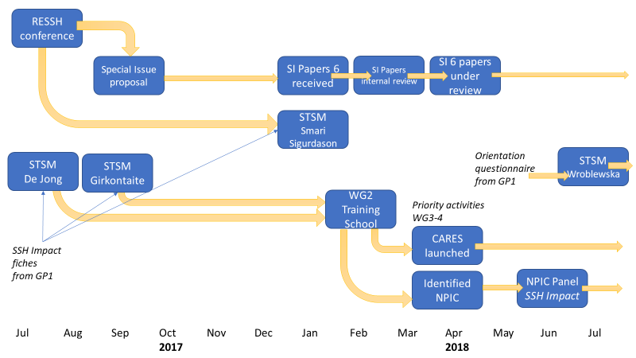
Workflow of WG2
.

Slide 72
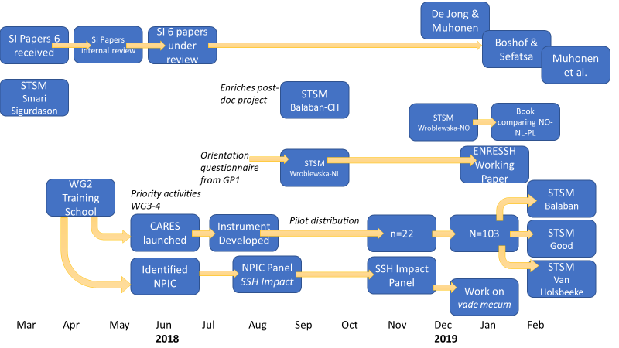
Workflow of this work period

Slide 73
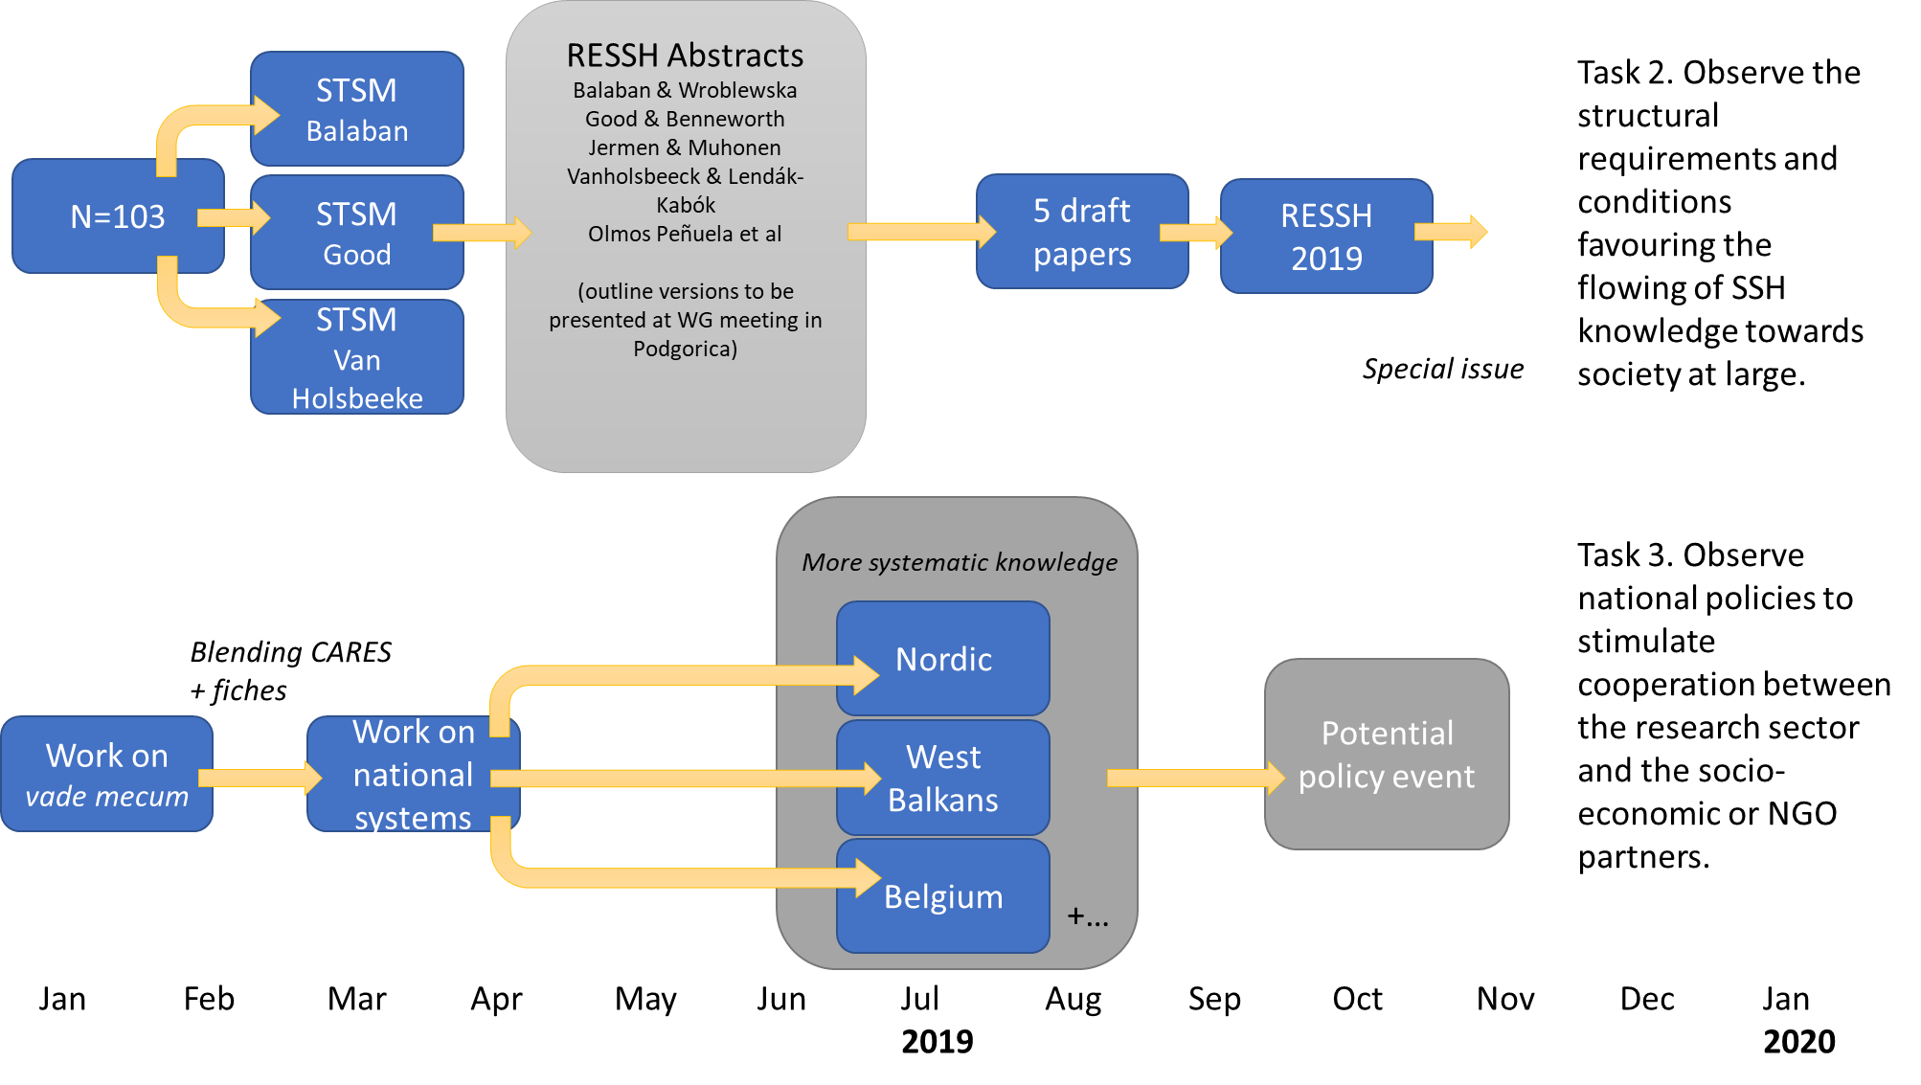
Workflow for Year 4

Slide 74
Progress: tasks and deliverables for WG2
Our main deliverables are
  D1 Scientific papers on societal relevance of the SSH
    6 papers submitted for a SI of Research Evaluation (post RESSH17)
    1 working paper ready to be published in ENRESSH series
    5 papers under preparation for RESSH 2019
    C. 3 miscellaneous chapters using RESSH material
  D2 Policy brief about stimulating societally relevant research
    Focus of Yr 4 – based on findings of STSMs in Yr 2/ 3.1, 3.2
  D3 Recommendation and guidelines for proof-based impact narratives
    Development and testing of Fiche approach
    Development of stylized typology of SSH Impact
  D4 Training school about increasing the visibility of SSH relevance to society
    Croatia, 12-15 February 2018

Slide 75
RESSH Special Session
Nelius Boshoff and Mpho Sefatsa Creating impact through ‘productive interactions’: An example from South African research on maritime piracy
Eiríkur Smári Sigurðarson Drowning by Numbers: Evaluating Social Capacities
David Budtz Pedersen, Jonas Grønvad and Rolf Hvidtfeldt Mapping the societal impact of SSH – a literature review
Gunnar Sivertsen & Ingebord Meijer Frameworks for understanding the societal relevance of the humanities
Paul Benneworth, Julia Olmos-Peñuela and Reetta Muhonen Towards a common understanding on the societal impact of SSH research

Slide 76

Research Evaluation Special Issue
Stefan P.L. de Jong & Reetta Muhonen, Who benefits from exante societal impact evaluation in the European funding arena? A cross-country comparison of societal impact capacity in the social sciences and humanities.
Nelius Boshoff and Mpho Sefatsa, Creating research impact through productive interactions: An example from South African research on maritime piracy.
Reetta Muhonen, Julia Olmos-Peñuela & Paul Benneworth, From productive interactions to impact pathways: understanding the key dimensions in developing SSH research societal impact
David Budtz Pedersen, Jonas Gronvald and Rolf Hvidtfeldt, Methods for mapping the impact of social sciences and humanities, a literature review.
Eiríkur Smári Sigurðarson, Drowning by numbers: social capacities, impact, and the humanities,
Gunnar Sivertsen and Ingeborg Meijer, Normal versus extraordinary impact: How to understand, evaluate and improve research activities in their relations to society,
Jack Spaapen and Gunnar Sivertsen, Introduction

Slide 77
STSMs in the Grant Period
Six STSMs were held for WG2 in this period
  Marta Wroblewska (Paul Benneworth, NL) Delineating the field of SSH impact: lessons from an expert survey (12.07-01.08)
  Corina Balaban (Marlene Isele, CH), Societal impact of SSH research: the case of Switzerland (23.10-05.11)
  Marta Wroblewska (Jon Holm, NO) Comparative study of Norwegian and UK impact case studies (05.11-23.11 & 10.12-14.12)
  Brad Good (Rita Faria, PT) Hierarchies, disciplinary norms and power in academia: impact as emancipation or tension? (10.02-28.02)
  Corina Balaban (Sarah De Rijcke, NL), Motivations of ECRs to engage in impactful research & relationship with academic identities (11.02-28.02)
  Marc Vanholsbeeck (Andrea Peto, HU) The diversity of impact evaluation and academic careers: accounting for local context (20.02-06.03)

Slide 78
Planning for SSH Impact
Invited by organisers of SSH Impact conference to organise a Roundtable
Proposal entitled “Building strong knowledge exchange ecosystems to stimulate SSH valorization: Reflecting the value of diversity of European SSH impact contexts”
Proposal eflecting the findings emerging in GP1 and Training School to properly account for different national impact environments in evaluation.
Paul Benneworth & Jack Spaapen participated in the Scientific Committee on behalf of ENRESSH.

Slide 79
Vienna Roundtable
Roundtable at the conference “Pathways to impact”: « Building strong knowledge exchange ecosystems to stimulate SSH valorisation. Policies and support structures for SSH valuation and impact »
Round–table discussion with chair: Paul BENNEWORTH, CHEPS – Center for Higher Education Policy Studies at the TU – University of Twente.
Discussants: - Gemma DERRICK, LU – Lancaster University; - Slaven MIHALJEVIĆ, MZO – Ministry of Science and Education of Republic of Croatia - Jon HOLM, Research Council of Norway - Natasa JERMEN, LZMK – Miroslav Krleža Institute of Lexicography - Poul HOLM, Trinity College Dublin
Key messages
  We need to generate new academy, bottom up, educate new generation of impact
  proposal for translational SSH research
  infrastructure for moving knowledge
  impact skills are important, need to invest for that
  training, we need different kind of instruments, to nurture inspiration
  getting people together
  we need to rethink categories, existing categories are nonsense

Slide 80

Invited on basis of participation in Vienna event to contribute to drafting the Guidelines on how to successfully design and implement mission-oriented research programmes.

Slide 81
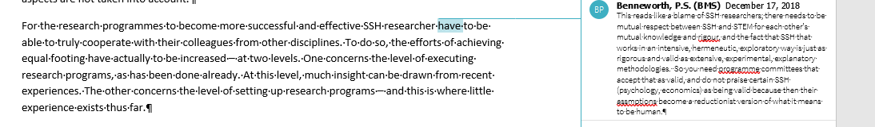
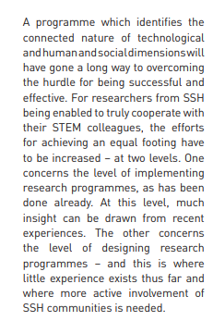
Letting ENRESSH’s voice be heard
From the draft
To the final version

Slide 82
Careers & Social Impacts in SSH (CARES)
Joint activities between ECI SIG and WP 2:
  1. to understand how early career investigators perceive/search for/create social impact;
  2. to improve ways for social impact to be better integrated in early career researchers’ day to day research and teaching activities;
  3. To help early career investigators develop narratives about social impact, aiming at improving their career evaluation.
Questionnaire to ENRESSH ECI stakeholders + analysis → toolbox for managing SSH Impact to benefit ECIs (questionnaire now exists)
Questionnaire developed (and prospectively 103 responses, 50,000 words free text

Slide 83
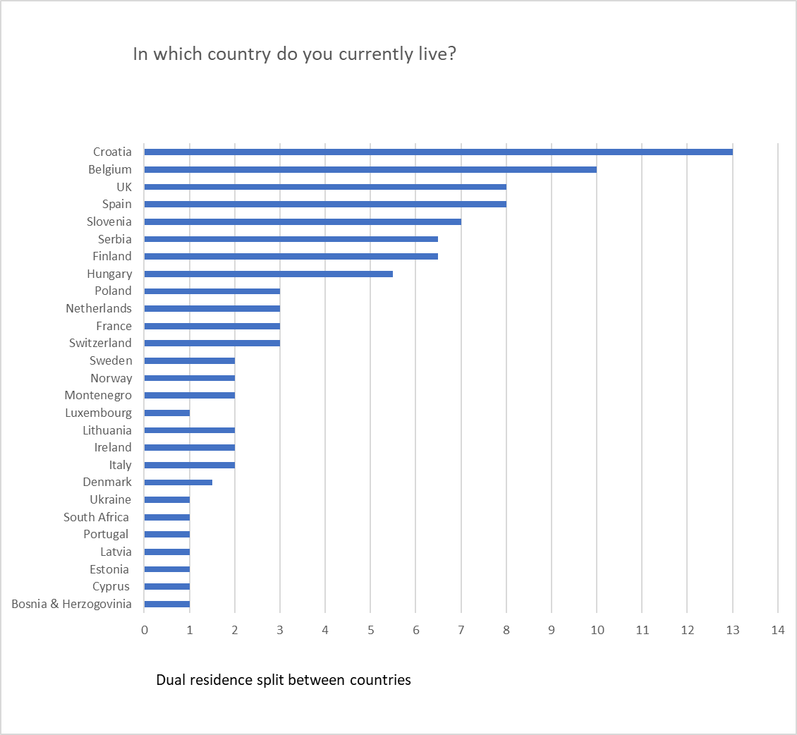

Slide 84
3. Follow-up of MoU objectives
Work groups
WG1. Conceptual frameworks for SSH research evaluation.
WG2. Societal impact and relevance of the SSH research.
WG3. Databases and uses of data for understanding, monitoring and evaluating SSH research.
WG4. Dissemination.
+ transversal special interest group for early stage researchers
+ transversal special interest group on book

Slide 85
Tasks of WG3
Our tasks in the action are
  1: To compare publication patterns across countries and disciplines
  2: Analyse characteristics of dissemination channels
  3: Develop rules and procedures for databases
  4: Design a roadmap for a European SSH research information system
  5: Develop alternative metrics

Slide 86
3. Follow-up of MoU objectives
Work groups
WG1. Conceptual frameworks for SSH research evaluation.
WG2. Societal impact and relevance of the SSH research.
WG3. Databases and uses of data for understanding, monitoring and evaluating SSH research.
WG4. Dissemination.
+ transversal special interest group for early stage researchers
+ transversal special interest group on book

Slide 87
Tasks of WG3
Our tasks in the action are
  1: To compare publication patterns across countries and disciplines
  2: Analyse characteristics of dissemination channels
  3: Develop rules and procedures for databases
  4: Design a roadmap for a European SSH research information system
  5: Develop alternative metrics

Slide 88
Update on deliverables of WG3 (1)
Studies of publication patterns presented and published
  Tim Engels et al (2018). Are book publications disappearing from scholarly communication? Aslib Journal of Information Management, https://doi.org/10.1108/AJIM-05-2018-0127
  Elea Gimenez-Toledo et al (2019). Taking scholarly books into account, part II: A comparison of 19 European countries in evaluation and funding. Scientometrics, https://doi.org/10.1007/s11192-018-2956-7
  Janne Pölönen et al (2018). Taking national language publications into account. STI 2018 Conference Proceedings, http://hdl.handle.net/1887/65223

Slide 89
Update on deliverables of WG3 (2)
Studies of publication patterns presented and published
Data collection regarding SSH journal article publication patterns in seven Europe countries (Czech Republic, Denmark, Finland, Flanders, Poland, Norway, Slovenia) and Québec completed (except for Québec), and five ideas for papers launched, one of which is already well underway
More focused data collection to explore Web of Science coverage by Michal Petr in the frame of his STSM
Qualitative analysis of four core Central European SSH journals in the frame of STSM by Ondrej Daniel

Slide 90
Planned deliverables and activities (1)
Further studies of publication patterns, among other things focusing on language use, gender, journal selection and open access
Recommendations for the construction and maintenance of publication channel lists to be submitted to the JDIS (Journal of Data and Information Science) special issue Differentiating Assessments ➔ extended abstract needed by March 30, submission by June 1st

Slide 91
Update on deliverables of WG3 (3)
Overview of existing databases for SSH outputs
  Following up on the 2017 report, paper published by Sīle, L., et. al. (2018). Comprehensiveness of national bibliographic databases for social sciences and humanities: Findings from a European Survey. Research Evaluation, https://doi.org/10.1093/RESEVAL/RVY016
  Additional (i.e. outside the regular COST-series) workshop ‘Working with national bibliographic databases for research output’ took place in Antwerp 10-11 September 2018, programme and presentations available https://www.uantwerpen.be/nl/centra/ecoom/programme/
  Website on national bibliographic databases launched https://ecoom.uantwerpen.be/sshdatabases
  Discussion of this event and website appeared mid November on the LSE impact of social sciences blog: https://blogs.lse.ac.uk/impactofsocialsciences/2018/11/13/towards-more-consistent-transparent-and-multi-purpose-national-bibliographic-databases-for-research-output
Notes:
Also mention Linda’s presentation at EuroCRIS 2018

Slide 92
Planned deliverables and activities (2)
Valencia meeting : presentation and publication of good practices manual for national bibliographic databases – discussion started here in Podgorica
Organisation of training school ‘Databases and uses of data for understanding SSH research’, planned for October 21-25th in Poznan, Poland

Slide 93
Update on deliverables of WG3 (4)
ENRESSH-VIRTA proof of concept of a European database for SSH outputs
  Report published by Hanna-Mari Puuska et al (2018), Proof of concept of a European database for social sciences and humanities outputs: description of the VIRTA-ENRESSH pilot. Helsinki, CSC & ECOOM, https://doi.org/doi:10.6084/M9.FIGSHARE.5993506
  Results presented by Hanna-Mari at EuroCRIS 2018 last June
  STSM by Dragan Ivanovic to bring international metadata standards, CERIF in particular, to the ENRESSH-VIRTA pilot, and make it comply with OpenAIRE guidelines
  Integration into Nordic integration project, and support by Nordforsk after presentation during the Nordic meeting on research information 29 May 2018 in Helsinki
  Further exploration of the ENRESSH register of book publishers during the ENRESSH Ljubljana meeting and ad hoc meeting 12-13 February in Madrid

Slide 94
Planned deliverables and activities (3)
STSM in Novi Sad in view of use of international metadata standards for ENRESSH-VIRTA
Brief to reach out to publishers and other stakeholders about the ENRESSH register of book publishers – to be launched soon after Podgorica meeting
STSM in Madrid in view of solid technical underpinning of ENRESSH register of book publishers

Slide 95
Update on deliverables (5)
Developments on alternative metrics
  Paper on grey zones in peer review by Janne Pölönen et al revised for Science and Public Policy
  Paper on qualitative in-depth study of Polish peer review label by Emanuel Kulczycki et al submitted to PlosONE
  Papers on open access availability of publications submitted for joint STI-ISSI conference by Janne, Gunnar, Emanuel and Raf
  Start of real collaboration with OPERAS-D / Hirmeos through STSM by Natasa Jermen at Open book publishers UK; follow-up STSM in GP4

Slide 96
Overview of planned deliverables
Further studies of publication patterns
Recommendations for the construction and maintenance of publication channel lists
Good practices manual for national bibliographic databases
Organisation of training school ‘Databases and uses of data for understanding SSH research’, October 21-25th in Poznan, Poland
Reach out to publishers and other stakeholders about the ENRESSH register of book publishers
Further explore alternative metrics for the SSH

Slide 97
3. Follow-up of MoU objectives
Work groups
WG1. Conceptual frameworks for SSH research evaluation.
WG2. Societal impact and relevance of the SSH research.
WG3. Databases and uses of data for understanding, monitoring and evaluating SSH research.
WG4. Dissemination.
+ transversal special interest group for early stage researchers
+ transversal special interest group on book

Slide 98
3. WG4
Disseminating
  Website updates and maintenance – GCW
  Newsletter – Stefan
  Social networks - Antun (Facebook) & Paul (Tweeter)
  Training – New Science Communication Officer

Slide 99
3. Follow-up of MoU objectives
Work groups
WG1. Conceptual frameworks for SSH research evaluation.
WG2. Societal impact and relevance of the SSH research.
WG3. Databases and uses of data for understanding, monitoring and evaluating SSH research.
WG4. Dissemination.
+ transversal special interest group for early stage researchers
+ transversal special interest group on book

Slide 100
Tasks and Deliverables: SIG for ECI
(1) to generate ideas for training school 2 organized within the Action → interviews & questionnaires.
(2) to prepare 'a manual' with helpful ideas for the future ECI in SSH, to draw the attention of evaluators and stakeholders to ECI position and problematic issues related to research evaluation in SSH.
(3) to publish article(s) on the topic of SSH ECI’s challenges concerning evaluation.

Slide 101
How will SIG goals be achieved?
STAGE 1: Interviews
4 interviews with ECI from SSH in most of the COST Action countries
STAGE 2: Questionnaires
Distributed to a big number of ECI in the COST Action countries

Slide 102
SIG : Summary of 3 (Interviews)
59 interviews with ECI conducted in 16 countries
4 focus groups covering interview material:
(1) Gender & geopolitical perspective (Stephanie, Karolina, Marc).
(2) Organisation vs individual (Michael, Rita, Reetta, Emanuel, Katya, Jose Gabriel, Fil, Bradley).
(3) Recruitment & communication channels (Marc, Haris, Karolina, Jolanta).
(4) Identities, audit cultures & societal impact (Gemma, Stefan, Reetta, Mimi, Georgios, Stevo).
Presentation of work in progess results (Podgorica, March 2019)

Slide 103
Summary of 3 (Questionnaire)
Questionnaire grid perfected during an STSM in autumn (Karolina Lendák-Kabók with Michael Ochsner);
Questionnaire piloted to the participants of the TS (Jan 2019);
Final version of the Questionnaire (March 2019);
Discussion of Questionnaire distribution channels and scope (Podgorica, March 2019);
Launch of the Questionnaire (April 2019).

Slide 104
Summary of 3 ("Manual")
Being an ECI: Opportunities, Threats / challenges, Available means of support, Missing means of support, Recommendations (Training school in Vilnius, January 2019);
Recommendations for ECI support based on the interviews (STSM results)

Slide 105
Summary of 3
Research articles planned:
Research article 1: The intersection of gender and geopolitical contexts in academics’ career narratives
Research article 2: Understanding the rules of the game: challenges and opportunities for early career investigators in SSH
Research article 3: Between a rock and a hard place: career demands versus good research for ECIs
Research article 4: Identities, audit cultures and the societal impact of research

Slide 106
Objectives of GP4
Finish work on the interviews;
Submit articles to research journals;
Launch the questionnaire;
Summarise questionnaire results;
Complete "manual" of recommendations.

Slide 107
ENRESSH Fellows
Paul Benneworth

Slide 108
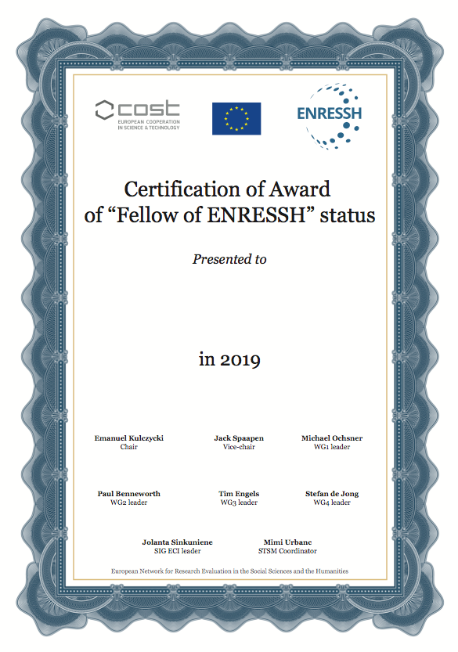

Slide 109
Rita Faria
Agnė Girkontaitė
Dragan Ivanović
Karolina Lendák-Kabók
Jorge Mañana-Rodríguez
Reetta Muhonen
Antun Plenković
Linda Sīle
Marc Vanholsbeeck
Marta Wróblewska

Slide 110
ENRESSH Day
Tim C.E. Engels & Marc Vanholsbeeck

Slide 111
BE-ENRESSH-day
↗ Dissemination meeting of ENRESSH results towards the Belgian community of researchers, stakeholders and policy makers
↗ one day, Tuesday April 30
↗ At Université Saint-Louis, an SSH university in Brussels
↗ With a key note by David Pontille
↗ And presentation of ENRESSH results regarding impact, careers, publication patterns and national bibliographic databases
↗ And a panel discussion

Slide 112
ENRESSH day
Can you also organize an ENRESSH-day in your country during GP4 in order to further disseminate our findings and recommendations?

Slide 113
ITC Grant Manager
Emanuel Kulczycki

Slide 114
The Conference Grants Coordinator performs the evaluation of each Conference Grant application.
The tasks include: evaluate applications, approve or reject these applications in e-cost, evaluate the scientific report after the mission, post-approve or reject the report.
The position is similar to the STSM Coordinator. However, without the call procedure.
We can ask this person to perform the administrative tasks with the grants, but the decision should be made with the agreement with the Steering committee.

Slide 115
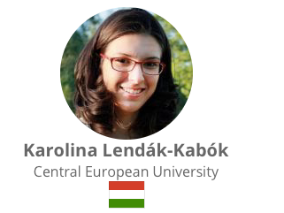
Steering Group’s suggestion:

Slide 116
Helsinki Initiative
Janne Pölönen

Slide 117

Helsinki Initiative on Multilingualism in Scholarly Communication

Slide 118

Organisations and networks
Federation of Finnish Learned Societies (TSV)
Co-operative body for 278 learned societies. Supports scholarly communication and publishing, promotes awareness and usage of research results, coordinated open science agenda.
Committee for Public Information (TJNK)
Expert body attached to the Ministry of Education and Culture that coordinates and promotes the dissemination of information.
Finnish Association for Scholarly Publishing
The mission is to strengthen the role of scientific publications, and to support the international community's scientific interaction for the development of scholarly publishing.
Universities Norway
Universities Norway (UHR) is a cooperative body for 33 accredited universities and university colleges.
European Network for Research Evaluation in the Social Sciences and the Humanities
COST Action bringing together more than 125 participants from 37 countries to propose clear best practices in the field of SSH research evaluation.

Slide 119
Why Helsinki Initiative?
Funding-models for national journals transitioning to open access
Public discussion organized in Helsinki, the 17th of January 2019
National language publishing and open access
11.00 Lea Ryynänen-Karjalainen (TSV): Opening
11.00-11.30 Emanuel Kulczycki (ENRESSH): Importance of national language publishing in Europe
11.30-12.00 Sami Syrjämäki (TSV): Open access of national language journals in Finland
Funding models for Open Access of national journals
13.00-13.30 Jadranka Stojanovski (University of Zadar): Croatia
13.30-14.00 Vidar Røeggen (Universities Norway): Norway
14.00-14.30 Emanuel Kulczycki (Adam Mickiewicz University in Poznan): Poland
Important source of inspiration: Sivertsen, G. (2018) ‘Balanced multilingualism in science’, BiD: textos universitaris de biblioteconomia i documentació, 40

Slide 120
Why multilingualism in scholarly communication?
Research is international. That's the way we like it!
Multilingualism keeps locally relevant research alive. Protect it!
Disseminating research results in your own language creates impact. Endorse it!
It is vital to interact with society and share knowledge beyond academia. Promote it!
Infrastructure of scholarly communication in national languages is fragile. Don't lose it!
The signatories of the Helsinki Initiative on Multilingualism in Scholarly Communication support the following recommendations to be adopted by policy-makers, leaders, universities, research institutions, research funders, libraries, and researchers.

Slide 121
Recommendations
1. Support dissemination of research results for the full benefit of the society
Make sure it is a merit for researchers to disseminate research results beyond academia and to interact with heritage, culture, and society.
Make sure that equal access to researched knowledge is provided in variety of languages.
2. Protect national infrastructures for publishing locally relevant research
Make sure that not-for-profit journals and book publishers have sufficient resources and support to maintain high standards of quality control and research integrity.
Make sure that transition to open access does not put national journals and book publishers in peril.
3. Promote language diversity in research assessment, evaluation and funding systems
Make sure that in expert-evaluation high quality research is valued regardless of publishing language or publication channel.
Make sure that in metrics-based systems journal and book publications in all languages are adequately taken into account.

Slide 122
Next steps
Helsinki Initiative launch the 3rd of April 2019
www.helsinki-initiative.org a permanent website provided by the Federation is going to be available in different languages
  Read the initiative in all language versions
  Sign the initiative as organization or individual
  Background and contact information
"In all languages" campaign is a wake-up call for policy-makers, leaders, universities, research institutions, research funders, libraries, and researchers to promote multilingualism in scholarly communication. Participate by posting in Twitter or Facebook a statement or video of your or your colleagues’ support for multilingualism in scholarly communication, of course #InAllLanguages.
Defining key terms in context is an essential task for signatories of this initiative. The founding signatories are aware of significant structural differences in scholarly communication between countries and disciplines. Thus no universal definitions are valid and dialogue in defining terms is considered an essential element in developing a stronger scholarly communication across the world.

Slide 123
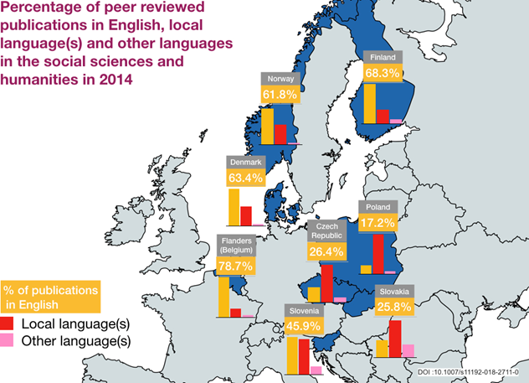
Join the Helsinki Initiative!
ENRESSH to become one of founding signatories
Initiative supports the ENRESSH main aim to advance best evaluation practices
Initiative is supported by research conducted by all ENRESSH working-groups
Initiative can be our collaborative effort to create ENRESSH impact
How to contribute?
Sign & participate in the “In All Languages” campaign
Help translate the initiative to different languages
Encourage colleagues and organisations to sign
Publish about the initiative your language

Slide 124
ENRESSH
as a signatory of the Helsinki Initiative

Slide 125
Long-term planning
Emanuel Kulczycki

Slide 126
Scientific planning
Secondary objective 1
To improve the understanding of how SSH fields generate knowledge, through upscaling research conducted in local and national contexts.
Secondary objective 2
To observe what kind of scientific and societal interactions characterize SSH disciplines in general, and some in particular.
Secondary objective 3
To understand and explain patterns of dissemination in the SSH, through confrontation of information stored in national databases and field interviews.
Secondary objective 4
To bring together all types of researchers whose tools and methods can help tackling the complex problems of SSH evaluation.
Notes:
Show word document

Slide 127
4. Scientific planning
Secondary objective 5
To bridge the gap between scholars in SSH research evaluation, research managers and policy makers.
Secondary objective 6
To put together a pool of specialists upon which external stakeholders may call to solve questions linked to the evaluation of SSH research.
Secondary objective 7
To prepare a roadmap for a European database of outputs of SSH research.
Secondary objective 8
To create a movement promoting the research in the SSH as a cornerstone of European framework programmes and research strategy.

Slide 128
4. Scientific planning – Grant period goals
To map national policy frameworks for generating social impact in a maximum of COST participating countries
To understand the impact of evaluation practices on ECI careers
To progress with the integration of data about SSH research from a maximum of COST countries
To release the third version of the overview of national evaluations systems
To produce an overview of peer review practices in the SSH
To propose better adapted approaches to evaluating the SSH

Slide 129
4. Scientific planning
To continue and increase the international dissemination of the activities and results of the Action
To publish at least two papers in internationally recognized journals or books
To further the comparability, understanding and visibility of national publication databases and of the information they contain
To progress with a forum on SSH research evaluation, intended to offer a joint learning platform for research evaluation specialists
To progress with the recommendations for evaluation agencies on the construction of national labelled lists of journals and publishers, classification of journals and publishers
To make stronger connections to external stakeholders (evaluation agencies, policy makers, HEI’s managers and directors)

Slide 130
STSM during GP4
15 planned STSM, in 2 or 3 calls
Two types of STSM
« closed »
« open »

Slide 131
4. Long term planning
Locations and dates of future activities
WG meeting, Valencia, 17 and 18 of September 2019
Training school, Poznan, 21-25 October 2019
Final Meeting, Paris, 6 and 7 of February 2020
Notes:
I have sent the template for reporting

Slide 132
Decisions
Except for exceptional and justified reasons, meetings of the Action MC may be held only if at least two- thirds of the COST Full or Cooperating Members participating in the Action are represented.
Decisions of the Action MC shall be taken by simple majority vote of Action MC members present or represented at the meeting, with one vote per COST Full or Cooperating Member participating in the Action. In the event of a tie, the procedure may be repeated. The Action Chair does not have the right to vote.
The minutes of an Action MC meeting at which at least two-thirds of the COST Full or Cooperating Members participating in the Action are not represented shall be approved by an Action MC vote according to Article 3.

Slide 133
4. Scientific planning
Resolution 1
The MC adopts the proposed working plan and authorises the MC Chair and steering committee to bring the necessary modifications (corrections, additions, specifications demanded by COST office).
Notes:
I have sent the template for reporting

Slide 134
4. Action budget planning
184.000 euros awarded to ENRESSH for the fourth GP
It is proposed to maintain the FSAC at 15%
Resolution 2
The MC approves a FSAC rate of 15% of the total scientific expenditure.

Slide 135
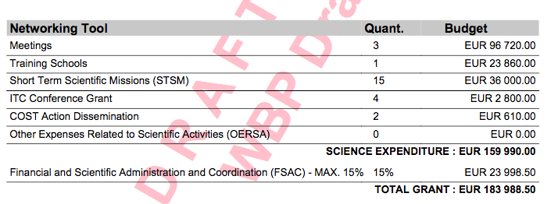
4. Action budget plannig

Slide 136
4. Action budget planning
Resolution 3
The MC adopts the proposed budget. Modifications to the reimbursement rates can be further voted before the meetings in order to allow participation of a maximum of members.

Slide 137
Any other businesses

Slide 138
5. AOB
Gender, age and country balance
The steering group will continue the same policy for balancing age, gender and country participation.

Slide 139
ENRESSH
Working Papers series

Slide 140

RESSH 2019

Slide 141
C
SECOND DAY
Presentation for
the session
Connecting to stakeholders
9h00–10h30
8th of March 2019

Slide 142
COST ACTION CA15137
WG Meeting, Podgorica, 8th of March 2019
European Network for Research Evaluation in the SSH

Slide 143
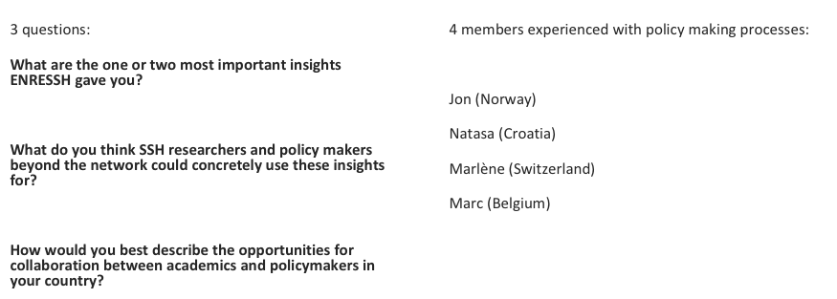
Questions

Slide 144
Some results | Regarding | Who don’t we reach? | What can we do to improve?
A very powerful, rich network | Researchers, policy makers | civil society, industry, | Identify collaborative projects, co-creation
Knowledge exchange | Individual ENRESSH members | People in the broader research community | Workshops, conferences at the local level on impact and impact pathways
Tension between research goals and policy ambitions | National and local evaluation systems, knowledge about the great variation | Those involved in research and evaluation policy (?) | Communicate results on different national systems, strengthen connections between researchers and policy makers
Open science | Development of open science policy for SSH, or lack of policy for SSH | Open science community | Engage with SWG openscience and innovation
Connection to Horizon Europe | SSH perspectives on impact, knowledge about ‘third mission’, mission oriented programs | Impact or transfer offices, those involved in impact strategy development | Inform national and international networks, ENRESS dissemination days

Slide 145
Connecting ENRESSH to stakeholders:
4 discussion themes
Break through the imitation game (STEM -> SSH, west -> east, Research universities -> other universities)
Ignite a cultural change: how do we get people to see the importance of SSH, how do we get SSH friendly /oriented evaluation systems
Best practices regarding strategy how to communicate results (micro, meso and macro level results)
Best practices regarding coalitions to take ENRESSH further after project ends (lobby organisations, professional organisations, institutions, etc.), both at the institutional, national, and international level

Slide 146
D
SECOND DAY
Presentation for
the closing
16h00
8th of March 2019
AC

Slide 147
COST ACTION CA15137
Closing, Podgorica, 7th of March 2019
European Network for Research Evaluation in the SSH

