Slide 1
Power and Agency
Bradley Good PhD Student Sociology VU Amsterdam

Slide 2
Background
Early Career Investigator
PhD student –> 8 years after completion of PhD
Vienna Meeting
Status hierarchies and norms of power in research impact: conceptual geographies of the ECI world
‘Mapping’ Agency/Autonomy and Restrictions on Creating Impact
“What are means/instruments by which autonomy & agency is constrained?”
“Are there things which ACTIVATE or MOBILISE autonomy & agency?”

Slide 3
Quantitative results

Slide 4
Quantitative Methodology
Sliced data 4 different ways
By Country
EIS Innovation Scale Position
Gender
Position
Averaged scores to create 1 indicative number for each question category
Example: By country, all Croatia scores averaged together for each question.
Looking for potential inequality and lack/boost of agency present in quantitative data

Slide 5
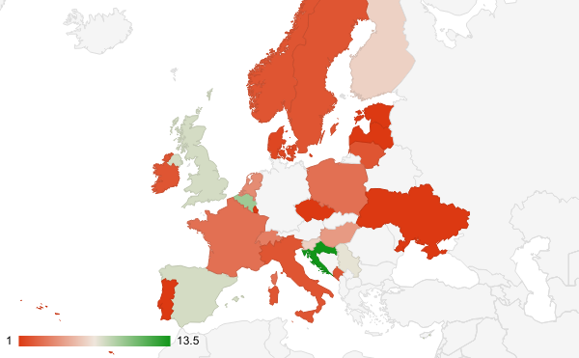
Our Respondents
Largest Country Groups:
Croatia – 13.5
Belgium – 9.5
Spain - 8
UK – 8
Serbia – 7.5
Slovenia – 6.5
Finland – 6.5

Slide 6
By Country Takeaways
1. No responses from residents of Germany, Romania, Albania, Macedonia, Greece, or Turkey
2. No East/West, North/south Europe divide
(Slovenia, Croatia)
3. Single country responses led to problematic data
Continued research opportunity: continue survey, targeting areas with only 1 or 0 respondents

Slide 7
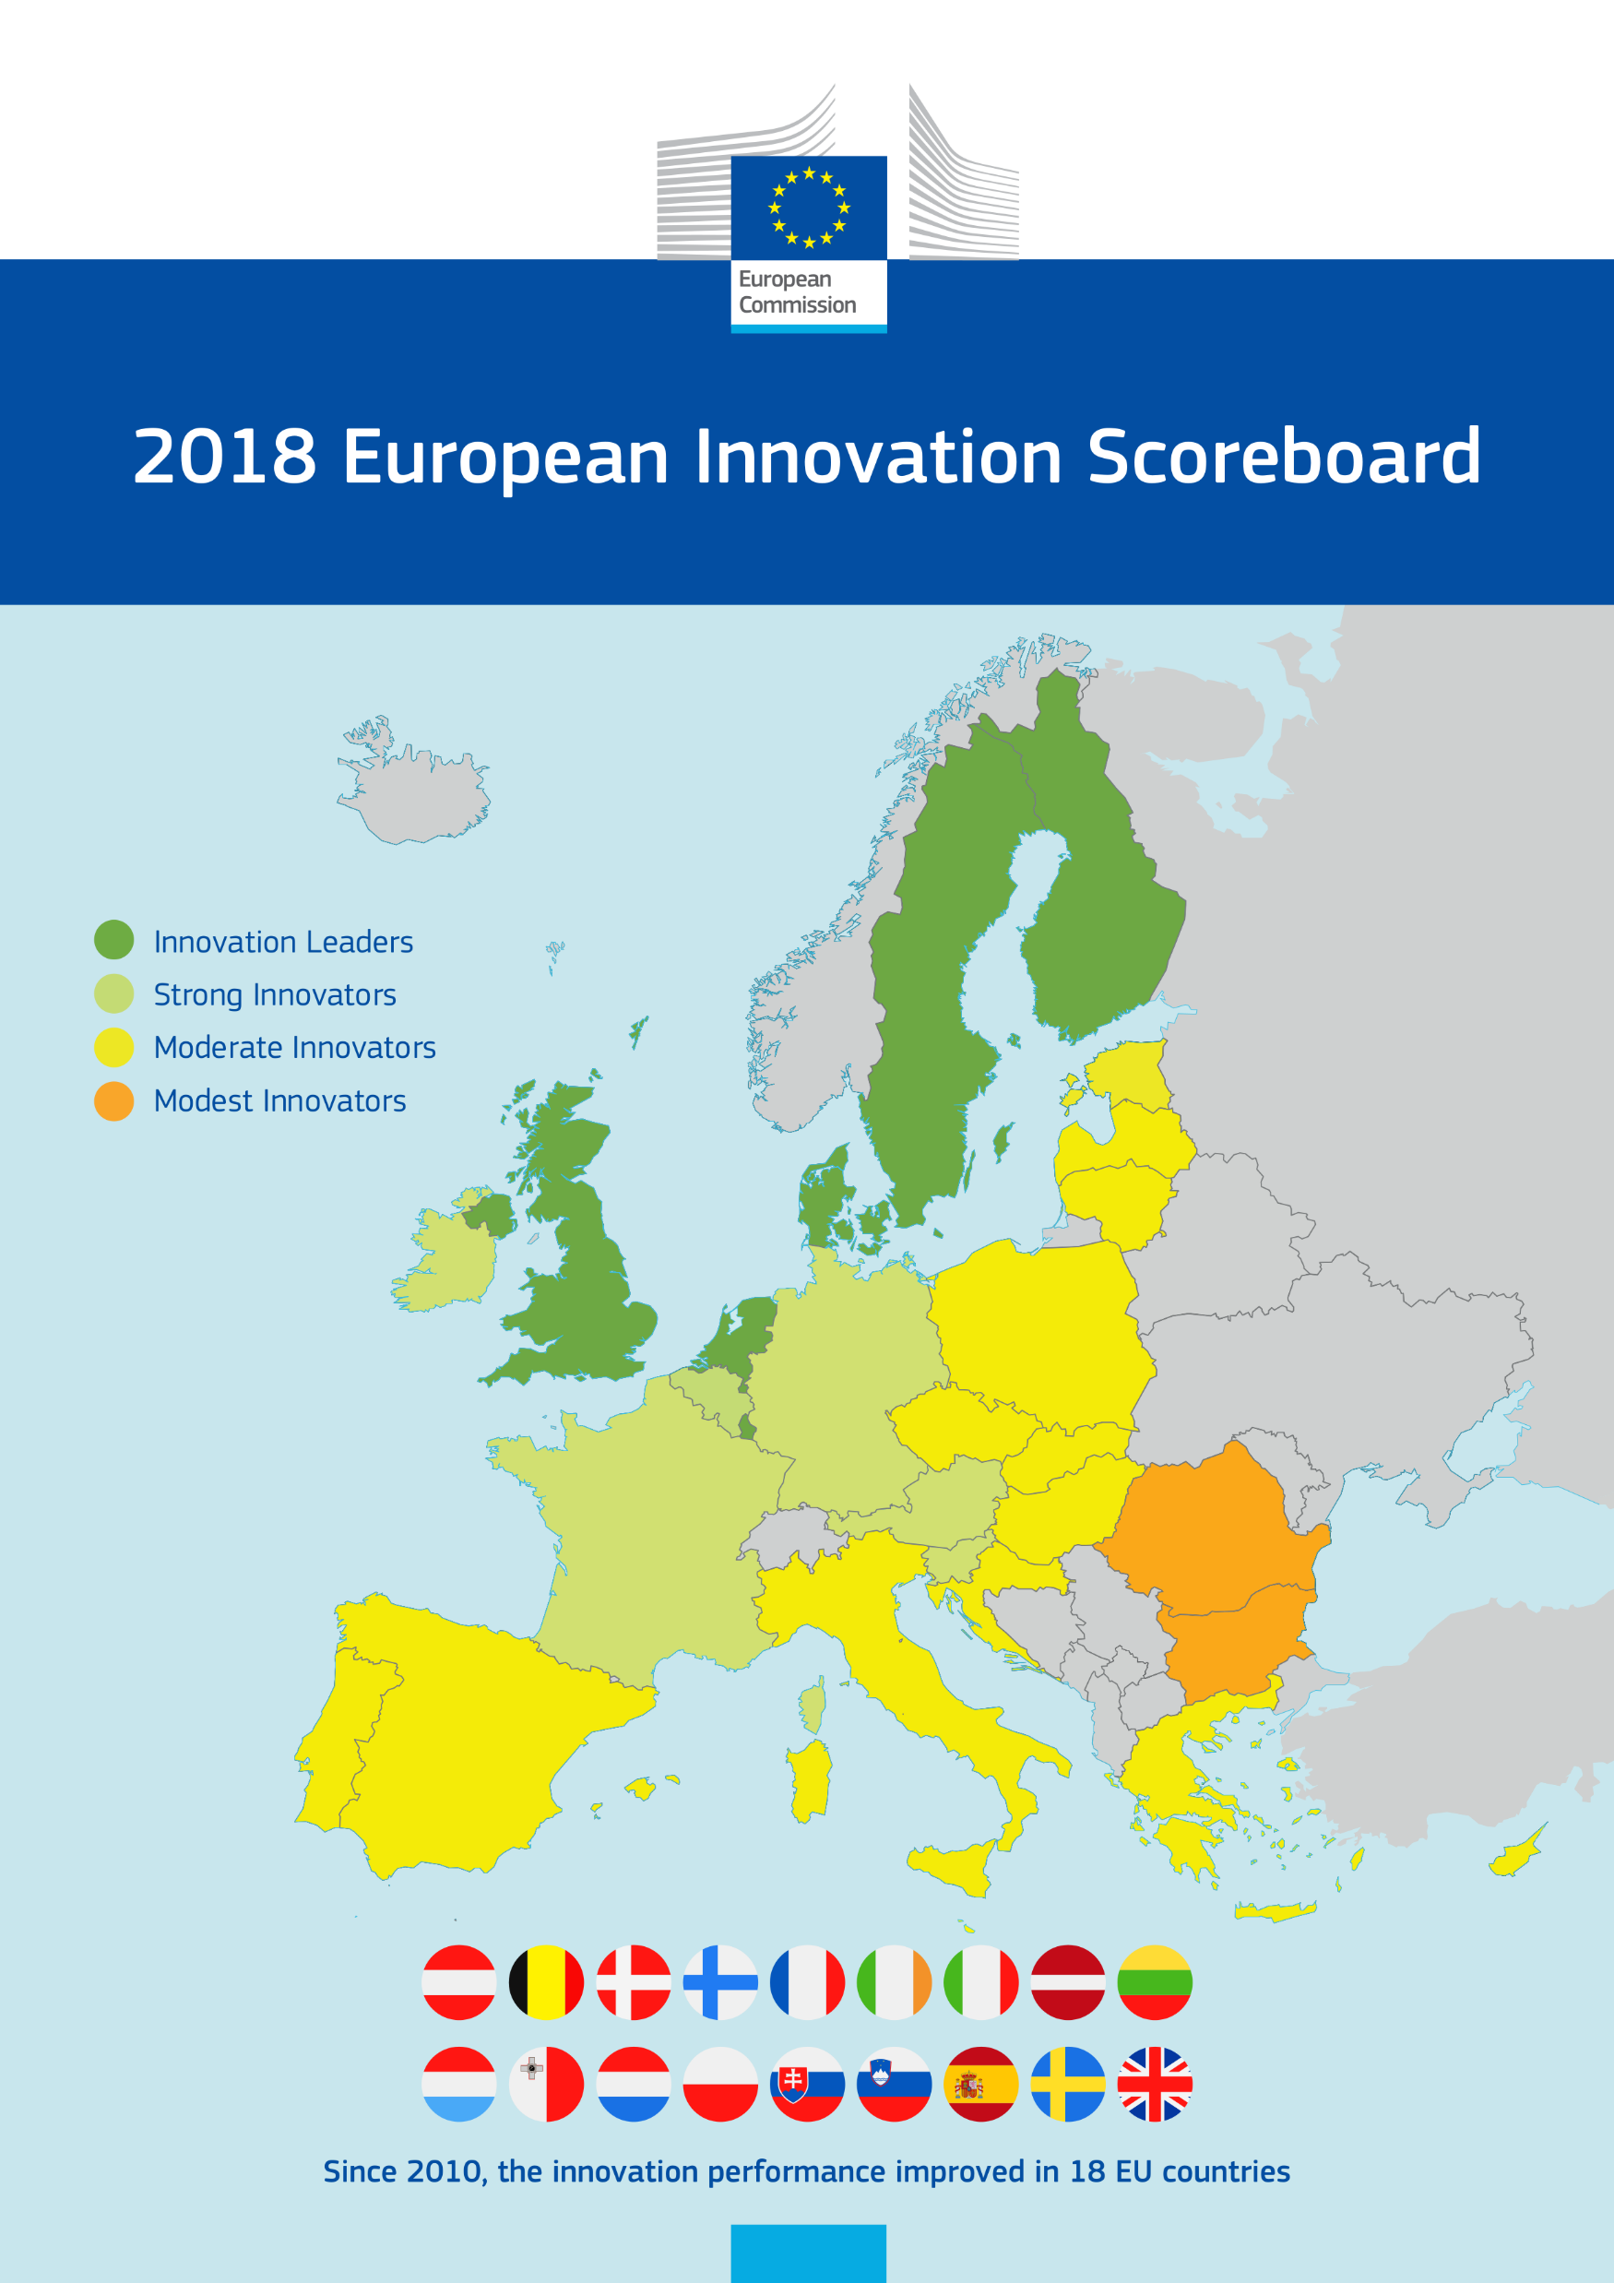
EIS Innovation Scale

Slide 8
EIS Takeaways
Likert scores consistent within Leader/moderate categories
More university/general support of impact = less problems with impact
UK still said more workload – potentially due to REF conditions

Slide 9
Our Respondents - Gender

Slide 10
Gender Results
Women
More confident of importance of research
Importance of impact to their own research
More motivated for social impact
Fewer tensions with aims
Men
Slightly more training and success to date
Self-reporting of more involved in creating social impact
Slightly more university support
More tensions with aims

Slide 11
Our Respondents - position

Slide 12
Position Takeaways
Researchers Most Positive
01
Importance of research
Importance of impact
Motivation to impact
Research assistants
02
No university support/emphasis
Everyone else
03
Impact is additional workload
PhD candidates
04
More university support than PhD students
High in university support/emphasis
Impact not additional workload

Slide 13
Qualitative Results

Slide 14
Theoretical orientation
Moving from a simple to ecosystem version of research impact

Slide 15
A simple model of what affects SSH research impact
Factors affecting the relationship
Researcher
User
Slide courtesy of Paul Benneworth

Slide 16
A first cut take on the impact ecosystem from the view of a SSH researcher
Slide courtesy of Paul Benneworth
Politics-influencers
Other international networks
Public sector
Funders
Civil society
NGOs
National HE system
Researcher
Institution
Policy Maker
National social sphere
Disciplinary field
Business
The power relationships from the researcher (ECI) to the element affect autonomy and agency

Slide 17
Methodology
Analysis Phase 1:
Mapping the impact ecosystem
Identifying three categories of interest
Stakeholders
Constraints on agency
Activation or mobilization of autonomy or agency

Slide 18
Public
Academic
Community
Researcher #41, Croatia
Gatekeepers/Powerful
STEM Prominence
Primary Societal impact channel
Other Researchers
Impact unimportant
Profit
Researcher #41
Colleagues
Collaboration

Slide 19
Public Life
Higher Education
Training Programs
Training Programs
Policy Makers
Scholars
Training Programs
Networking
Healthcare
Researcher #14
Primary Impact Pathways
Process of research
External Partners
Focus on monograph publication
Social and Community Projects
REF/TEF
Academy
Researcher #14, UK

Slide 20
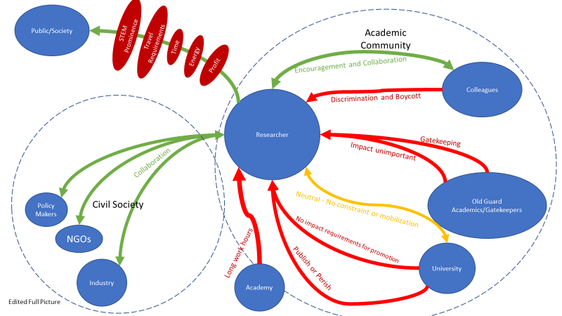

Slide 21
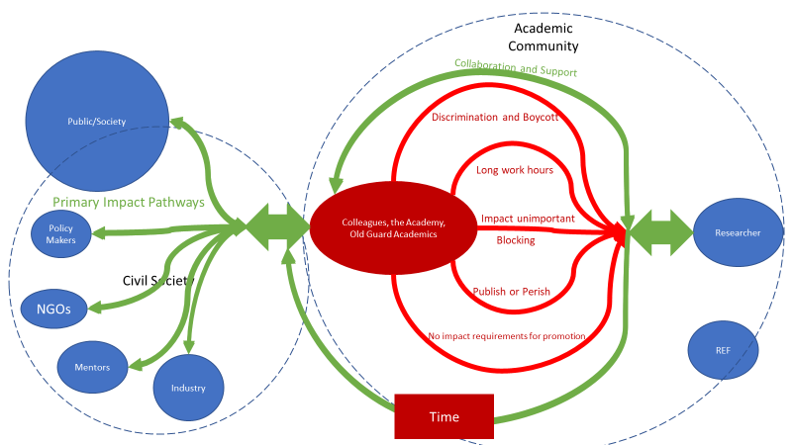

Slide 23
Creation of Coding
Stakeholder divisions
Blocking
Rewarding Impact
Training
Treating impact as orphan
Finances and funding
Other interesting things not classified elsewhere
Time pressures
Academic environment and standard practices
Collaboration to produce impact
Engaged public
Analysis Phase 2:
From the research ecosystem mapping, pulled major processes and themes

Slide 24
Original hypothesis

Slide 25
closer to reality

Slide 26
Coding

Slide 27
How/Why Engage the public?
#1 – Communication
#2 – Societal Contract
#3 – Activism/Policymaking
#4 – Public Funding

Slide 28
Who to produce impact with?
#1 – Policymakers
#2 – Stakeholders
#3 – NGOs
#4 – Industry, Communities, Senior Colleagues

Slide 29
What Factors in the Academy are inhibiting?
#1 – Publishing Tensions
#2 – Career Tensions
#3 – Universities
#4 – Discipline Culture

Slide 30
What time restrictions exist on Societal Impact?
Extra work!!!!

Slide 31
Initial conclusions - Qualitative
Communication is essential to ECI creation of societal impact
The most fruitful impact seems to be collaborating with policymakers and/or engaging in political activism
Environmental factors: publish or perish, tensions with employment and career advancement, university settings, and discipline culture are some of the main reasons why ECIs are not creating impact.

Slide 32
Pulling everything together
Data confirms that there is often a uniformity of experience for ECIs
Researchers seem to be more able to produce impact with fewer blocks/negative processes
Main issues are environmental and systemic throughout the academy
Only through reducing or eliminating these structural inequalities can we increase our societal impact

Slide 33
Next Steps
Closer exploration of differences between academic positions
How do colleagues and senior academics view ECIs?
Will additional country data begin to show divides between regions, EIS scores?
Further review of coding and categories
Potential additional survey gathering

Slide 34
Special Thanks
Paul Benneworth
Rita Faria

Slide 35
Questions?
Want to be my colleague or tell me how wrong I am?
Yell at me on Twitter or through good old e-mail! ☺
Twitter: @ecumenicmatter
E-mail: b.d.good@vu.nl

