Slide 1

European databases for research output
Good practices in database work
Linda Sīle, PhD Student in Social Sciences
Podgorica: March 7, 2019

Slide 2
Conceptualising database work
A few examples

Slide 3
Enrichment with external metadata
Use of metadata standards
Use of classifications
Validation of identifiers
Use of identifiers
Deduplication
Data retrieval
publication
Parsing
record in a national database for research output
I Data input
II Data processing
III Organisation of data collection and processing

Slide 4
Examples
!NB Based on the (limited) available information

Slide 5
#1 Bibliographic control
COBISS in Slovenia
Nation-wide standardised practice for bibliographic control
Education and licence for data entry

Slide 6
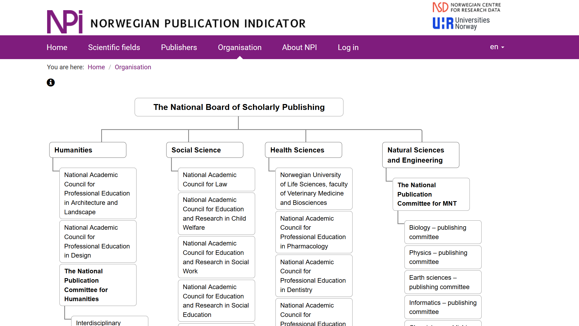
#2 Coordination between stakeholders
Norwegian Science Index
Well-defined coordination and responsibility scheme among the different stakeholds
Strong representation of the scholarly community
Multiple spaces to express (alternative) views

Slide 7
#3 Documentation
(also in English)
VIRTA, Norwegian Science Index, BFI
Elaborated manuals and guidelines on bibliographic record input
e.g.
COBISS, RIV
Detailed description of research output type classification

Slide 8
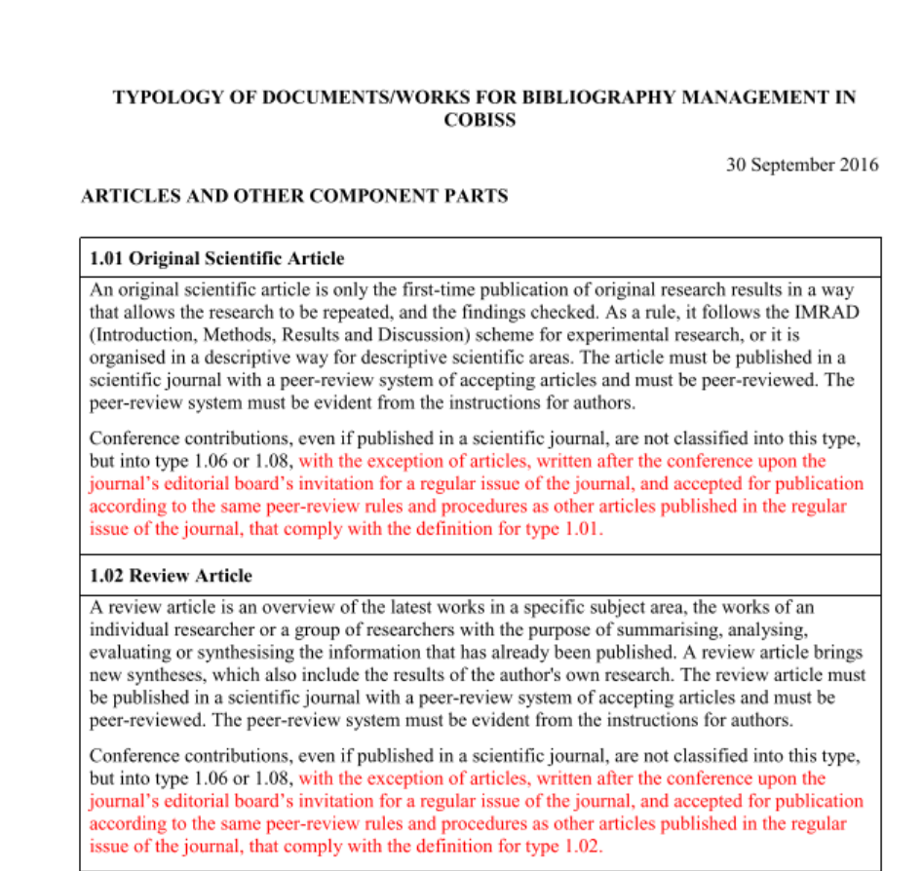
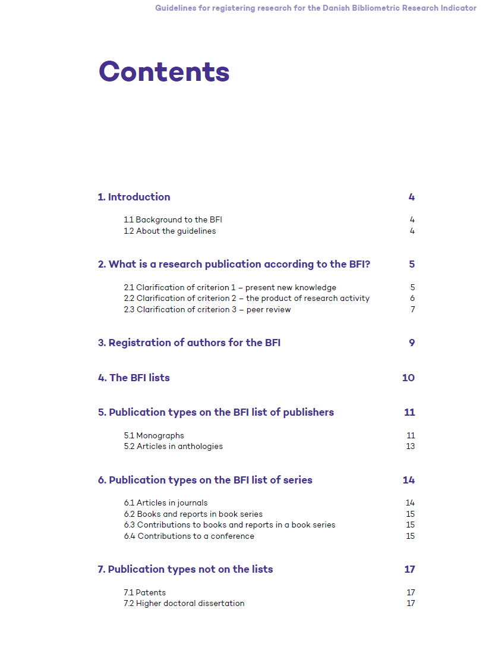
#3 Documentation
(also in English)

Slide 9
#4 Legal framework
VABB-SHW
Detailed legal framework that specifies the need to implement and maintain a database for research output

Slide 10
#4 Legal framework
VABB-SHW
Detailed legal framework that specifies the need to implement and maintain a database for research output

Slide 11
#5 Collaboration with publishers
RINC
Data transferred from publishers.
Reduced necessity for manual data input by research organisations.

Slide 12
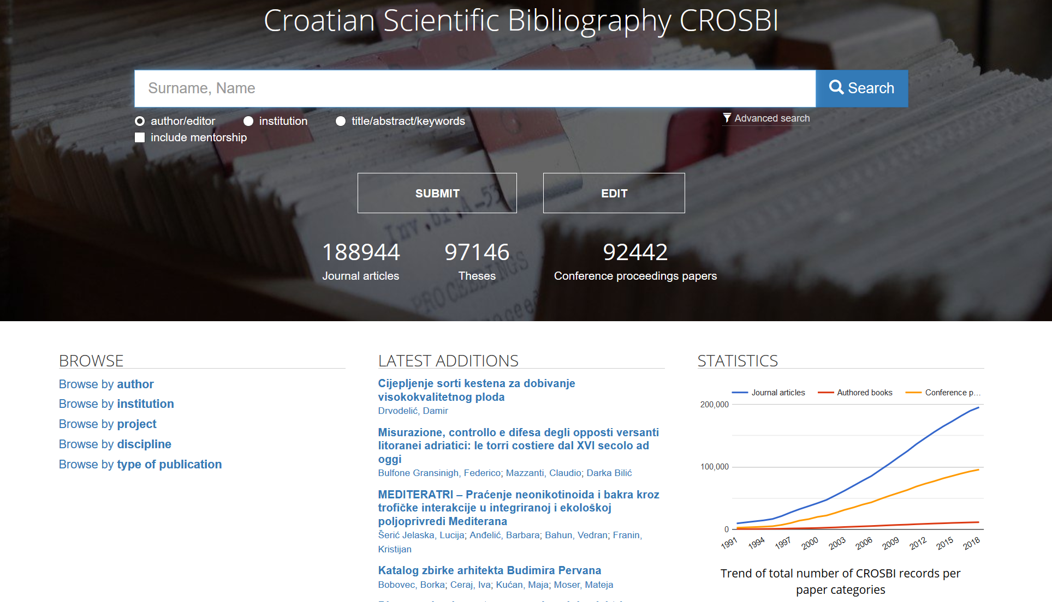
#6 Interface for information retrieval
CROSBI
Bibliographic data can be browsed and searched
Links to (OA) full-texts

Slide 13
#7 Persistent identifiers
For publications: DOIs
For authors: ORCID
For organisations: ?
Examples?

Slide 14
#?
What is missing?

Slide 15
Enrichment with external metadata
Use of metadata standards
Use of classifications
Validation of identifiers
Use of identifiers
Deduplication
Data retrieval
publication
Parsing
record in a national database for research output
I Data input
II Data processing
III Organisation of data collection and processing

Slide 16
Timeline
until April 30 Pooling ideas
June 1 First draft
Critical friends?
September 15 Manual complete

